Slide 1
Chapter 4
Solving a System of Linear Equations

Slide 2
Core Topics
(i) Gaussian Elimination Method (4.2)
(ii) Gaussian Elimination with Pivoting (4.3)
(iii) Gauss-Jordan Elimination Method (4.4)
(iv) LU Decomposition Method
(v) Inverse of a Matrix (4.6)
(vi) Iterative Methods (Jacobi, Gauss-Seidel) (4.7)
(vii) Use of MATLAB’s built-in functions for solving a system of linear equations (4.8)
(viii) Tridiagonal Systems of Equations (4.9)
(ix) Error, Residual, Norms and Condition Number (4.10)
(x) Ill-Conditioned Systems

Slide 3
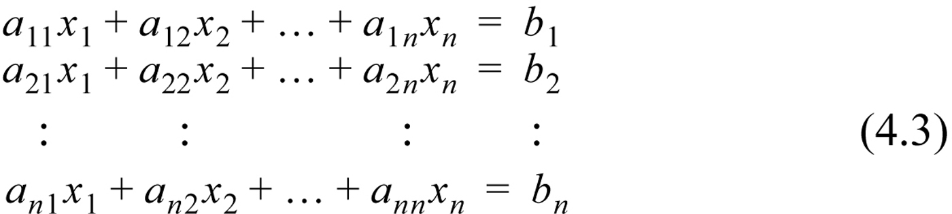
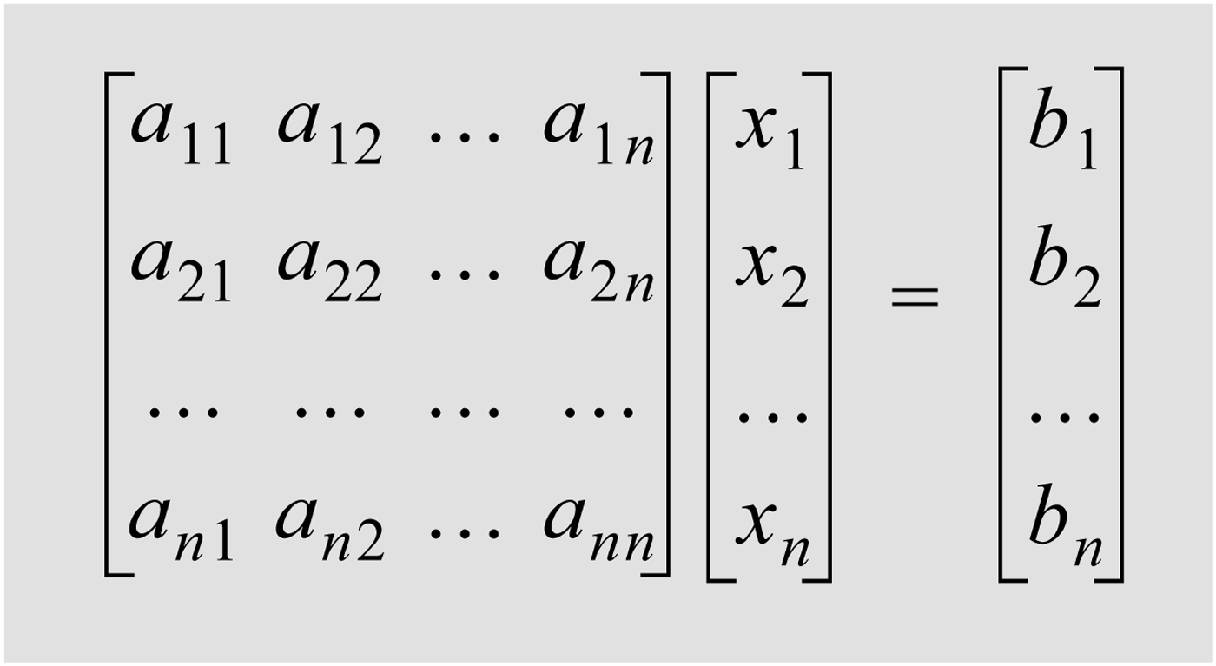
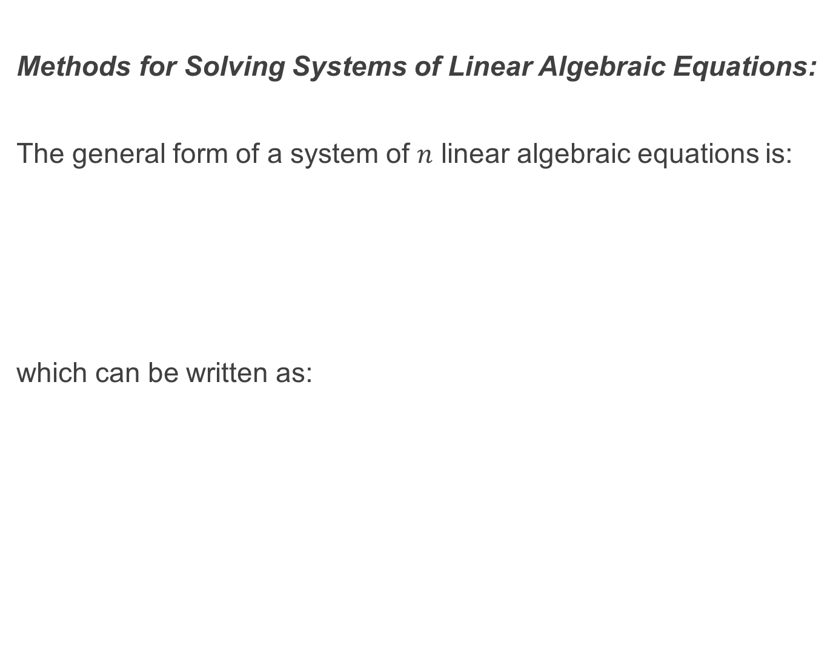
Methods for Solving Systems of Linear Algebraic Equations:
The general form of a system of $n$ linear algebraic equations is:
which can be written as:

Slide 4
Methods for Solving Systems of Linear Algebraic Equations:
These equations can be solved using analytic, direct or iterative (recursive) methods. The problem with analytic methods (such as Cramer’s Rule) is that it becomes practically impossible to compute when the number of equations is large. Orders of thousands are common for many applications.
With direct methods the solution is calculated using an efficient numerical algorithm which performs arithmetic operations on the equations.
With iterative methods an initial approximate solution is assumed and is then used in an iterative process to obtain successively more accurate solutions.

Slide 5
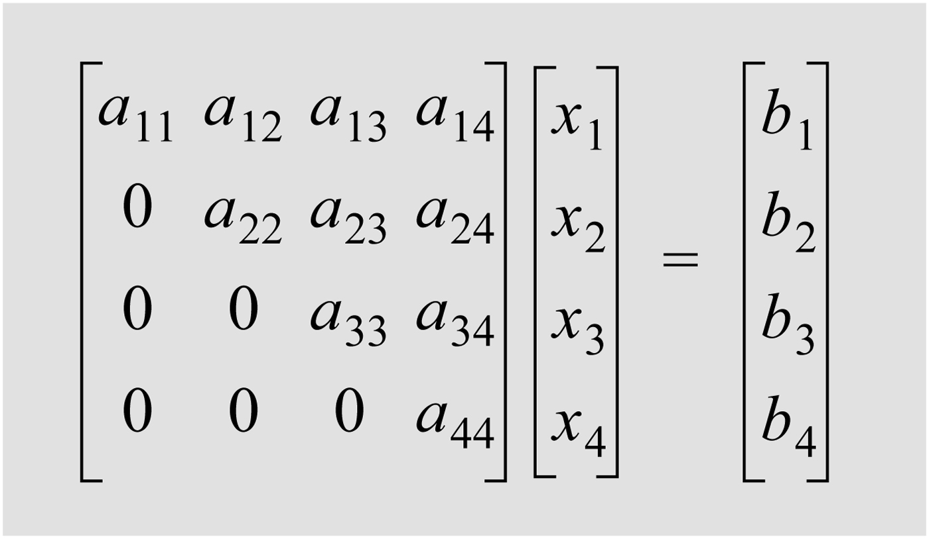
Direct Methods:
In direct methods the initial system of equations is manipulated to an equivalent system of equations that can be easily solved. Three systems of linear equations that can be easily solved are the upper triangular, lower triangular and diagonal forms.
The upper triangular form is this:

Slide 6
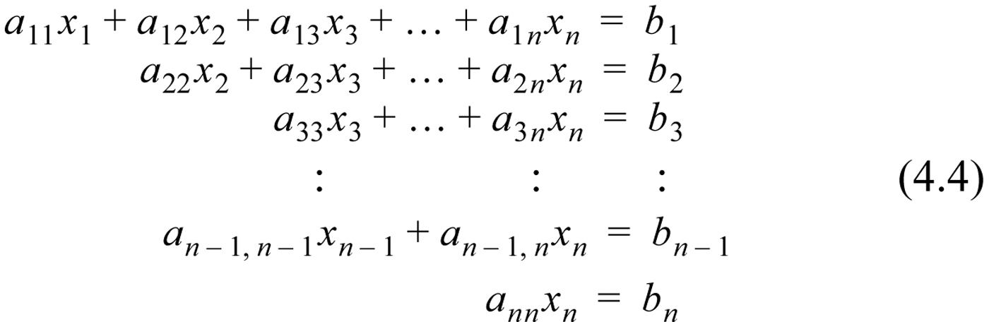
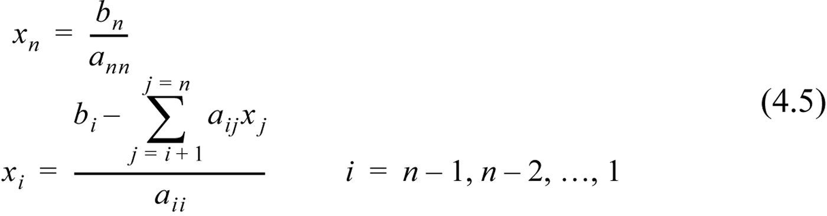
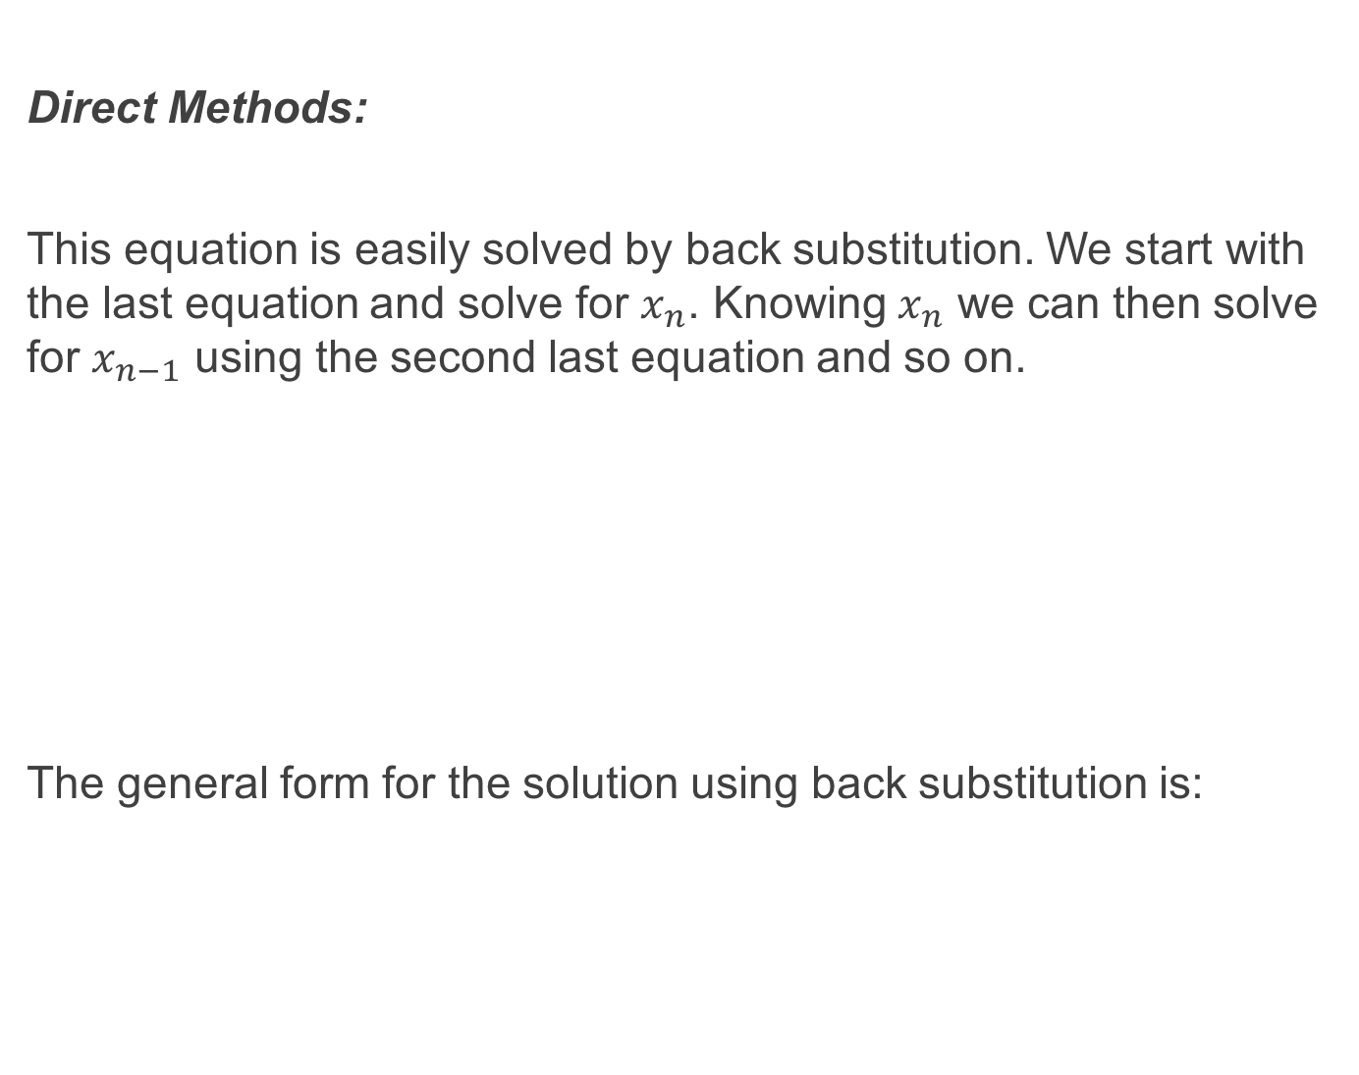
Direct Methods:
This equation is easily solved by back substitution. We start with the last equation and solve for $x_{n}$. Knowing $x_{n}$ we can then solve for $x_{n−1}$ using the second last equation and so on.
The general form for the solution using back substitution is:

Slide 7
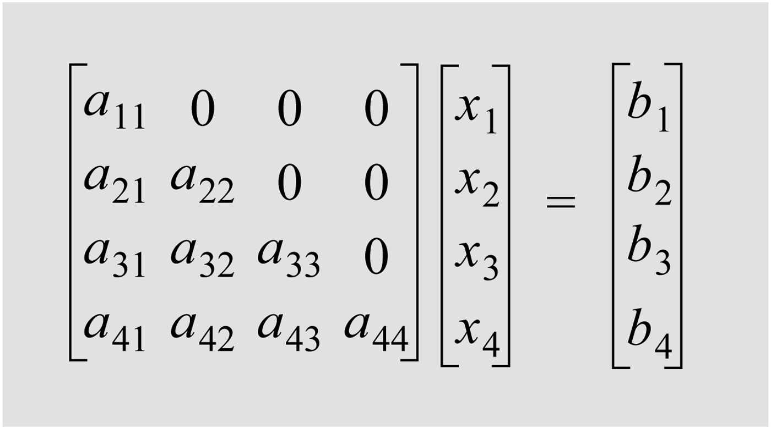
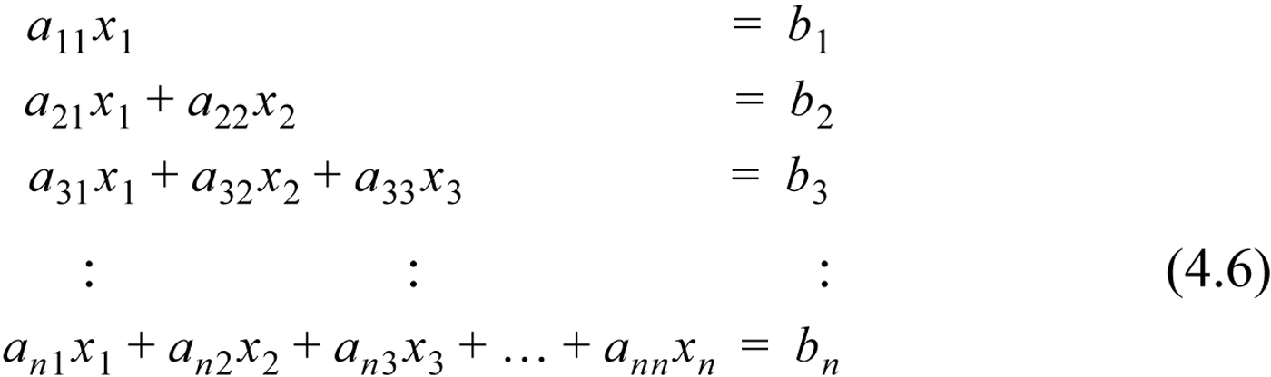
Direct Methods:
Likewise a lower triangular form can be solved using forward substitution:

Slide 8
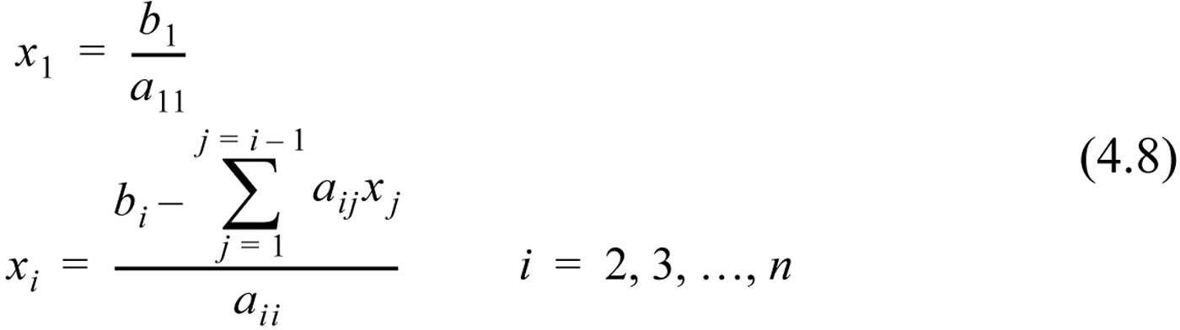
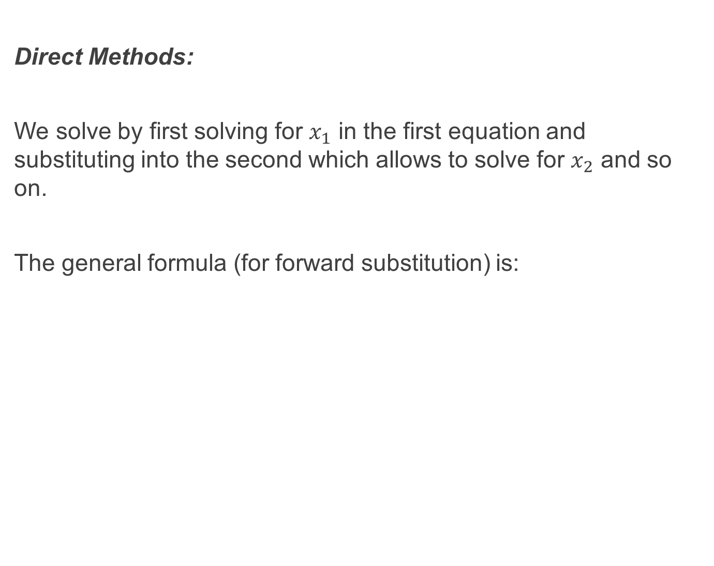
Direct Methods:
We solve by first solving for $x_{1}$ in the first equation and substituting into the second which allows to solve for $x_{2}$ and so on.
The general formula (for forward substitution) is:

Slide 9
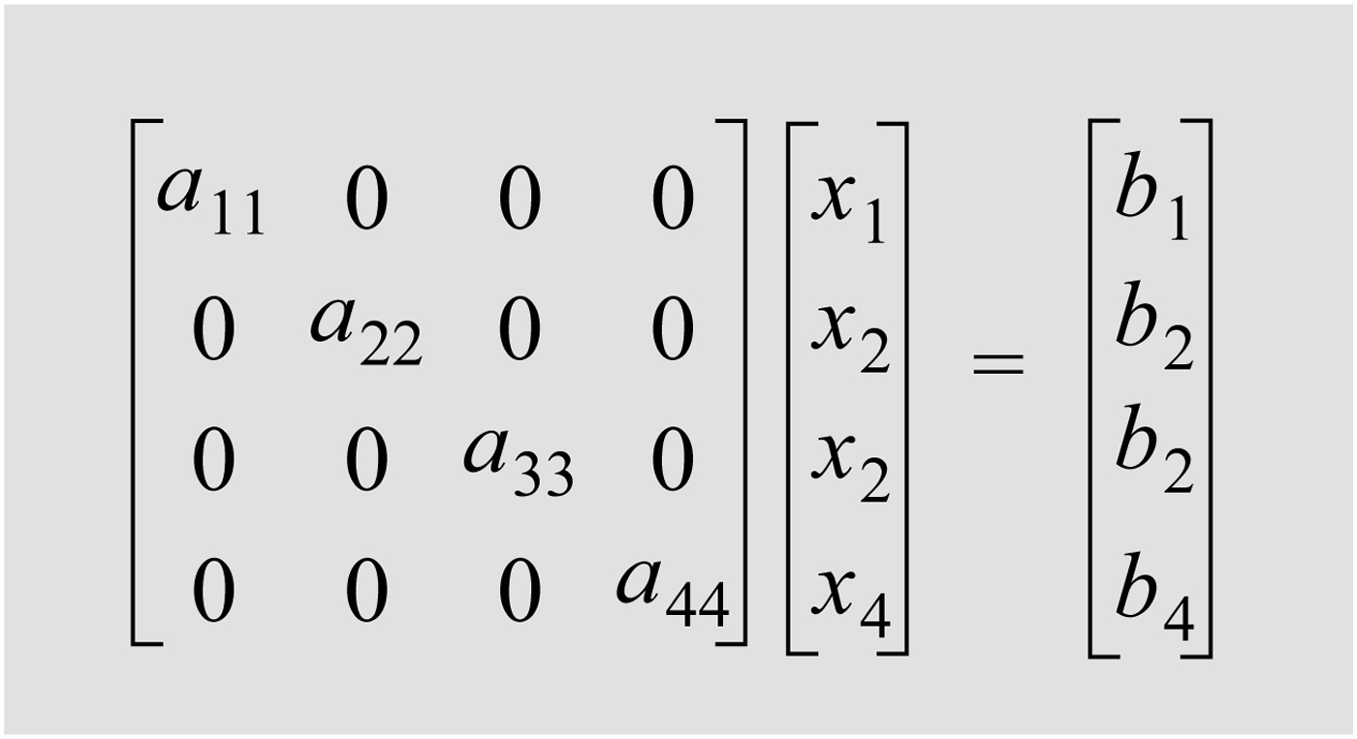
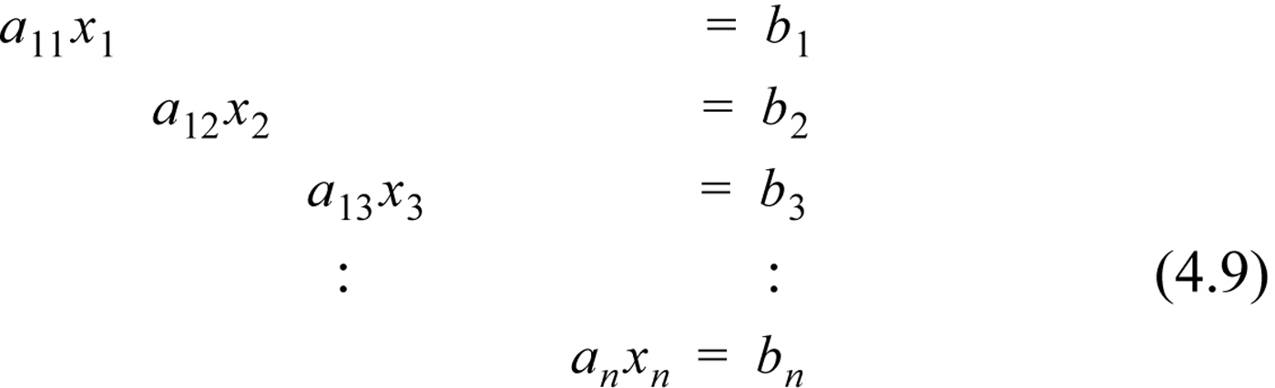
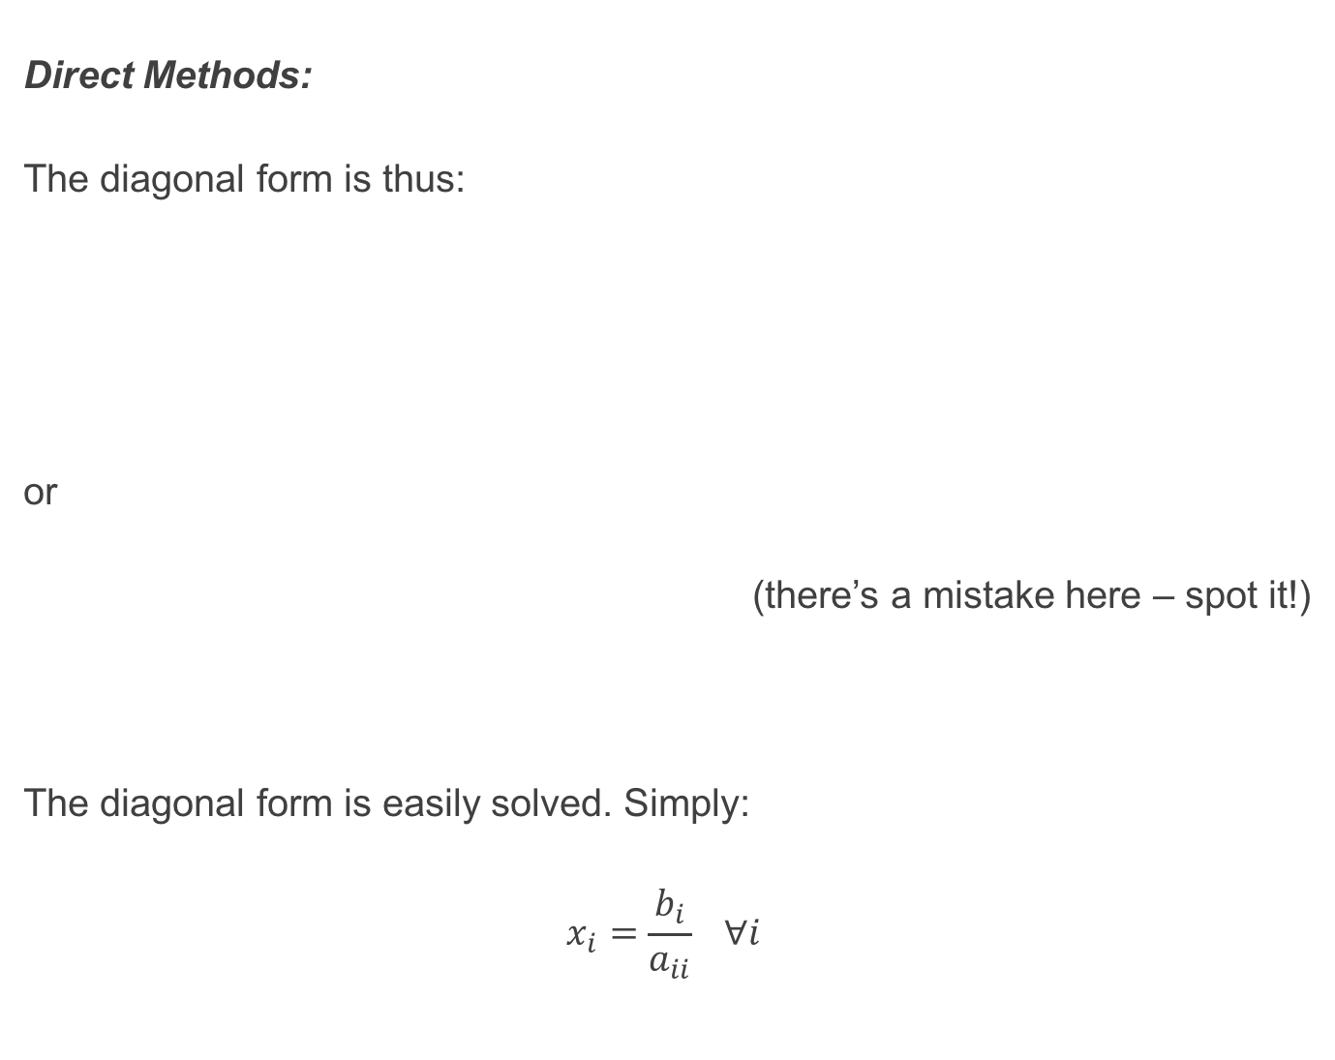
Direct Methods:
The diagonal form is thus:
or
(there’s a mistake here – spot it!)
The diagonal form is easily solved. Simply:
$$x_{i}=\frac{b_{i}}{a_{ii}} ∀i$$

Slide 10
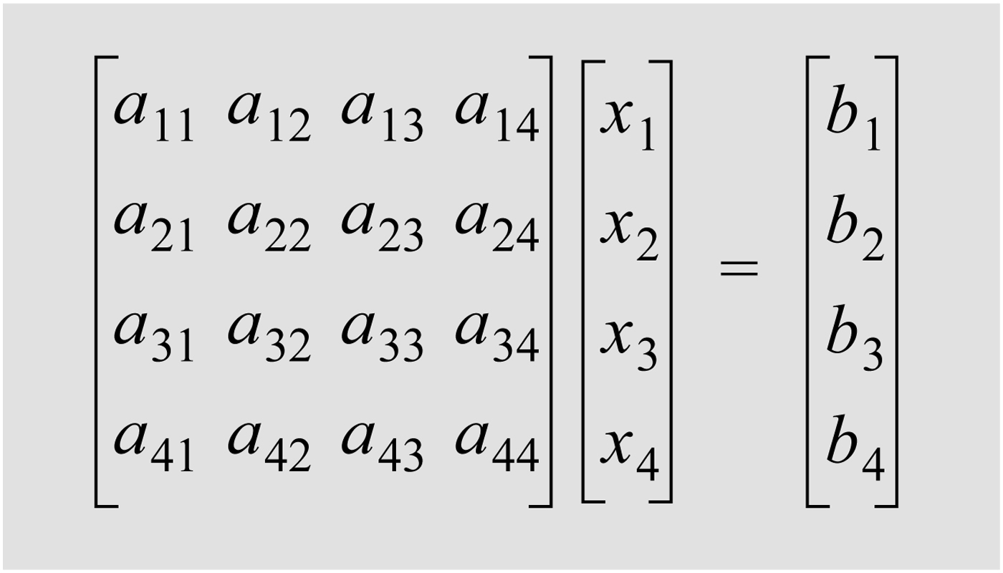
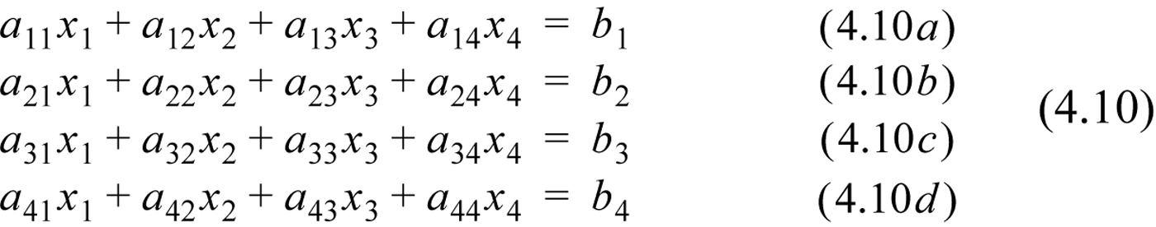
Gaussian Elimination: Gaussian Elimination:
Here the full set of linear equations is manipulated to be in upper triangular form – which can then be solved using back substitution. Given:
or

Slide 11
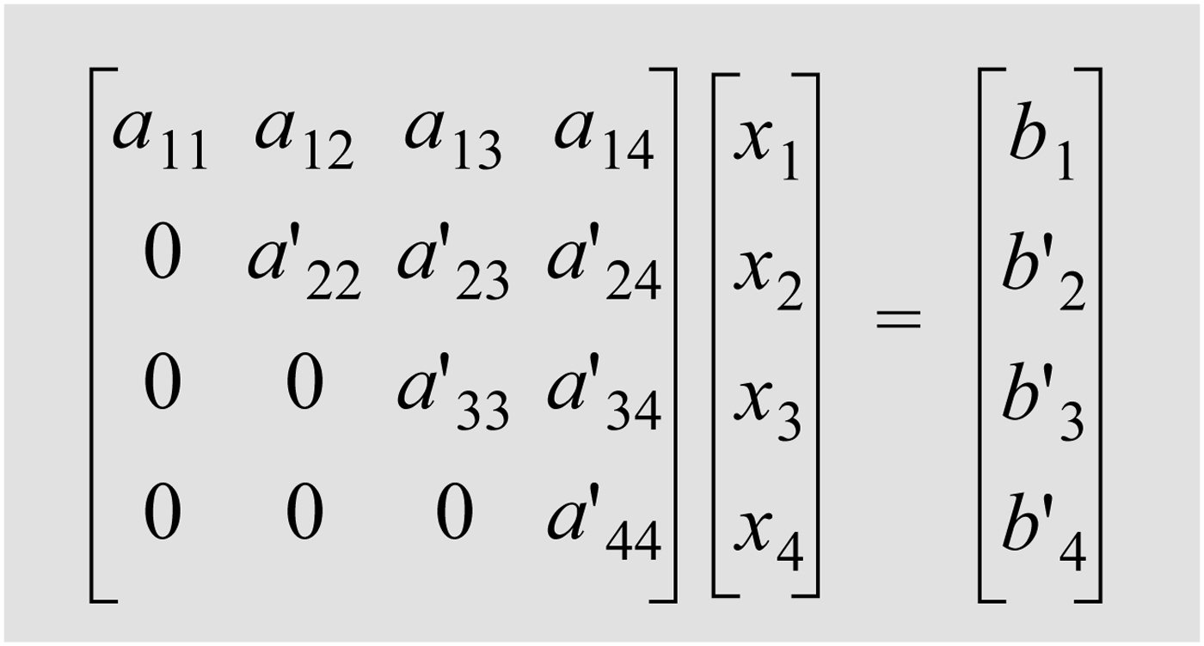
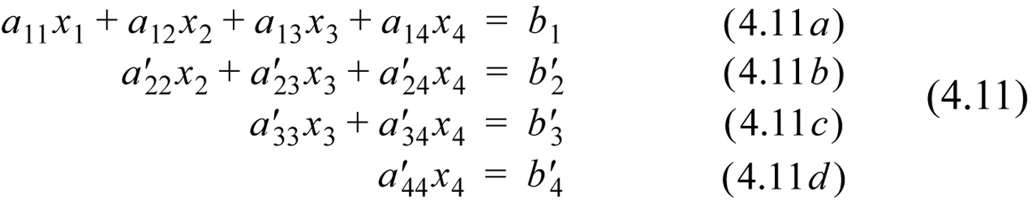
Gaussian Elimination:
We then manipulate the system of equations into an equivalent system which takes the form:
or

Slide 12
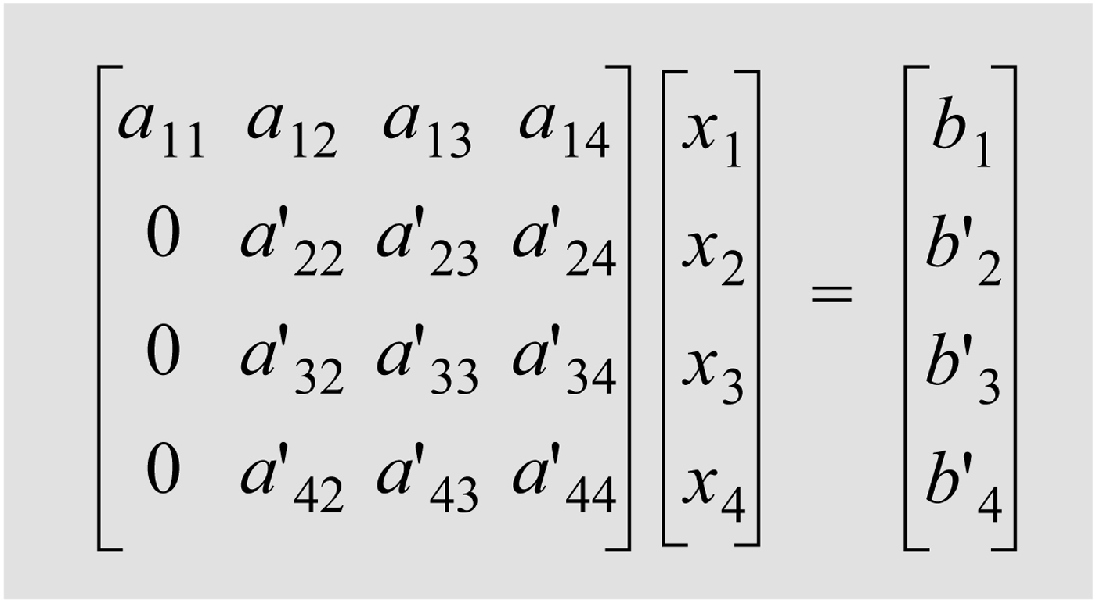
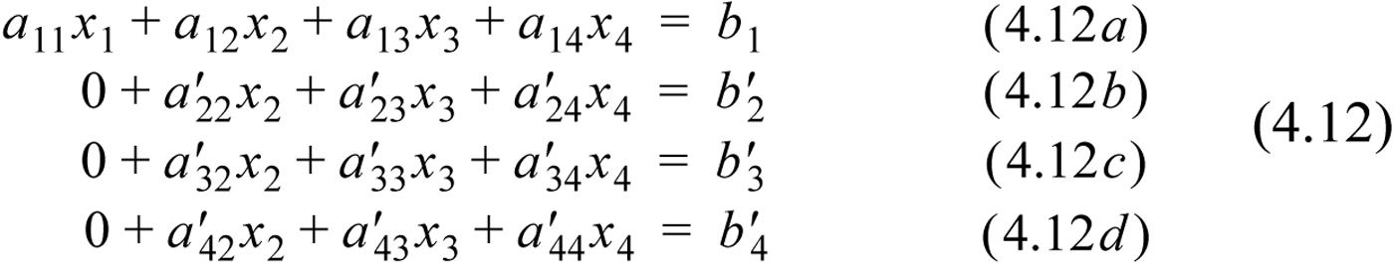
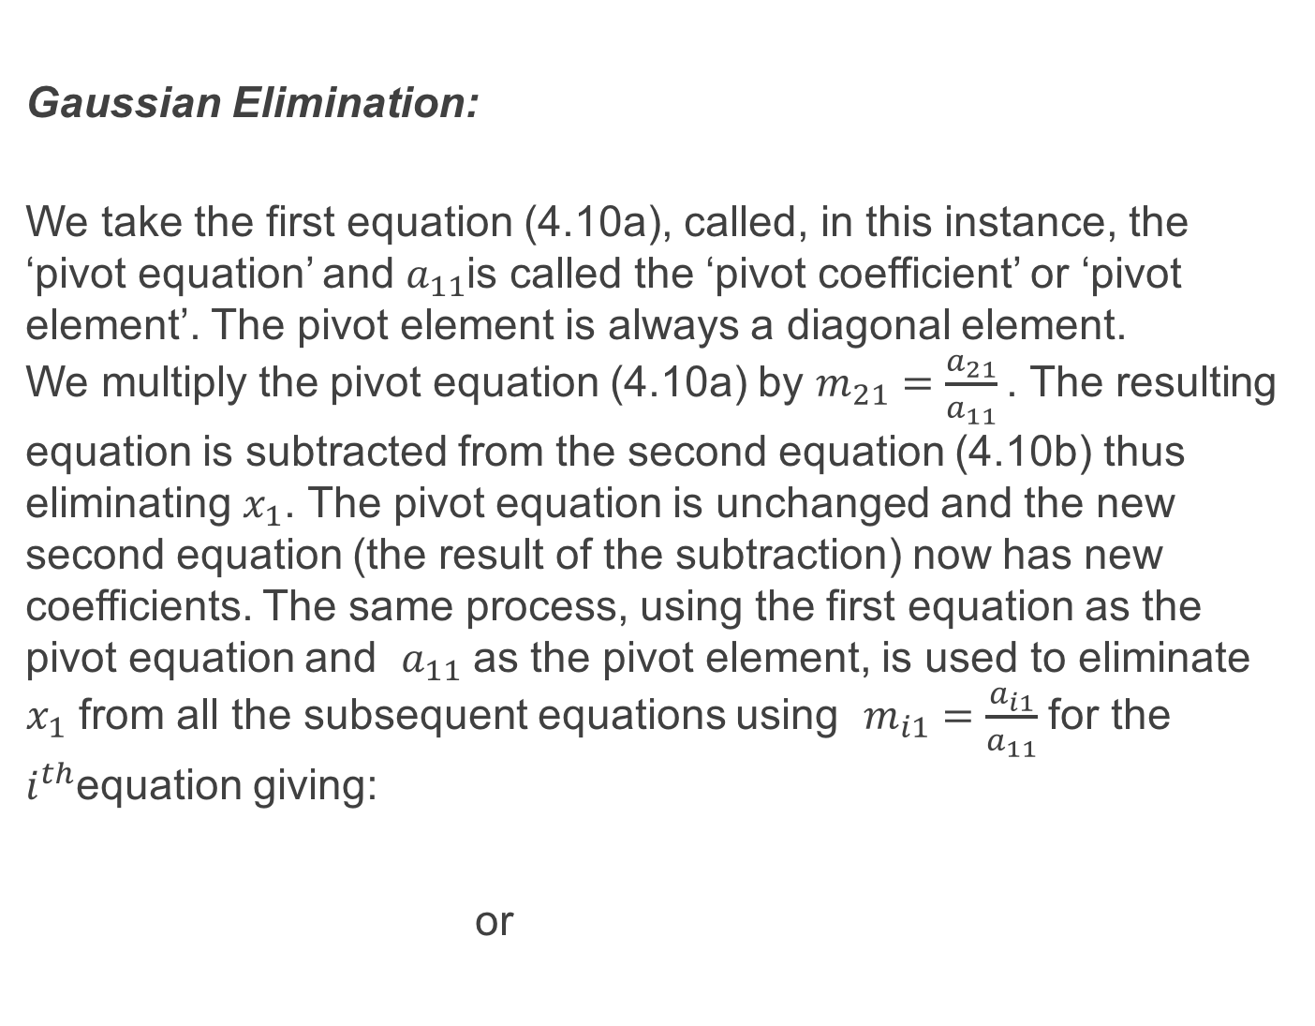
Gaussian Elimination:
We take the first equation (4.10a), called, in this instance, the ‘pivot equation’ and $a_{11}$is called the ‘pivot coefficient’ or ‘pivot element’. The pivot element is always a diagonal element. We multiply the pivot equation (4.10a) by $m_{21}=\frac{a_{21}}{a_{11}}$. The resulting equation is subtracted from the second equation (4.10b) thus eliminating $x_{1}$. The pivot equation is unchanged and the new second equation (the result of the subtraction) now has new coefficients. The same process, using the first equation as the pivot equation and $a_{11}$ as the pivot element, is used to eliminate $x_{1}$ from all the subsequent equations using $m_{i1}=\frac{a_{i1}}{a_{11}}$ for the $i^{th}$equation giving:
or

Slide 13
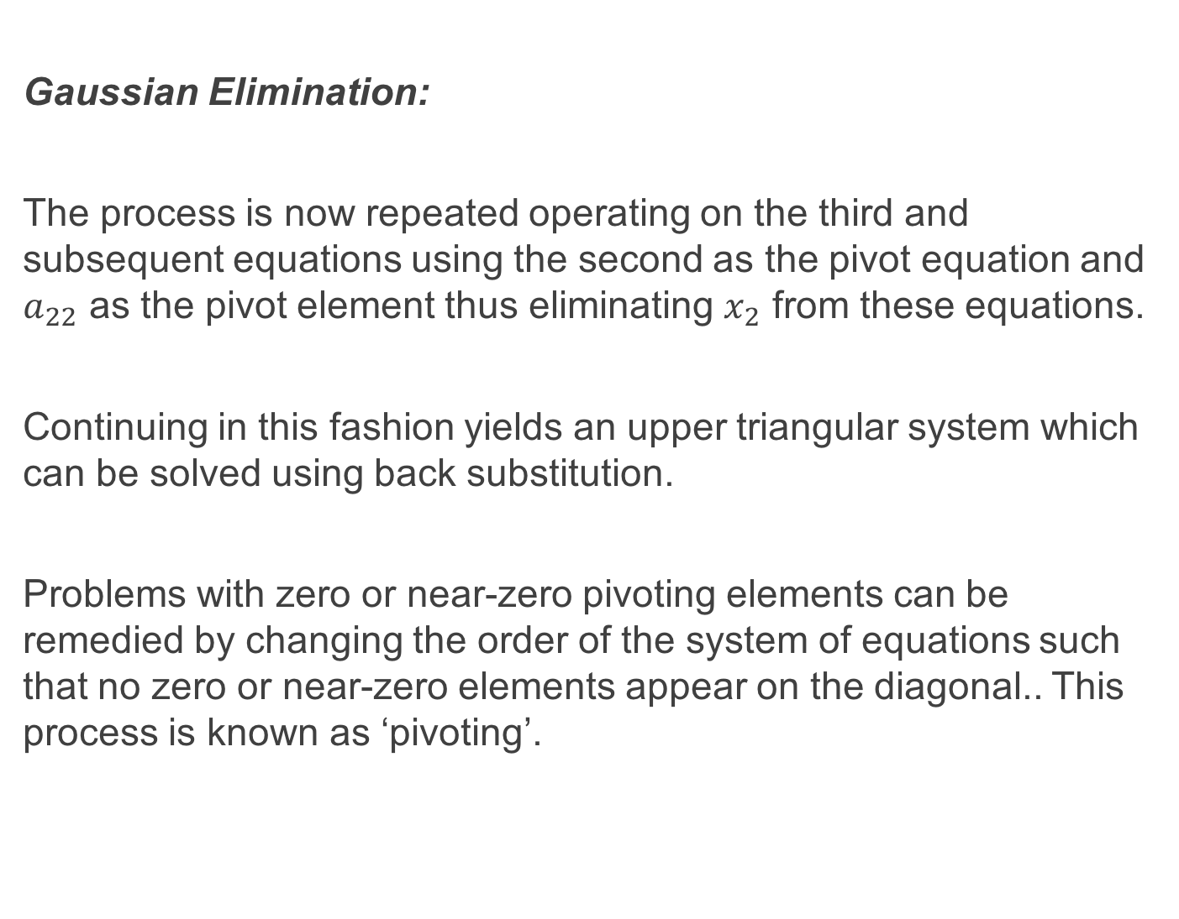
Gaussian Elimination:
The process is now repeated operating on the third and subsequent equations using the second as the pivot equation and $a_{22}$ as the pivot element thus eliminating $x_{2}$ from these equations.
Continuing in this fashion yields an upper triangular system which can be solved using back substitution.
Problems with zero or near-zero pivoting elements can be remedied by changing the order of the system of equations such that no zero or near-zero elements appear on the diagonal.. This process is known as ‘pivoting’.

Slide 14
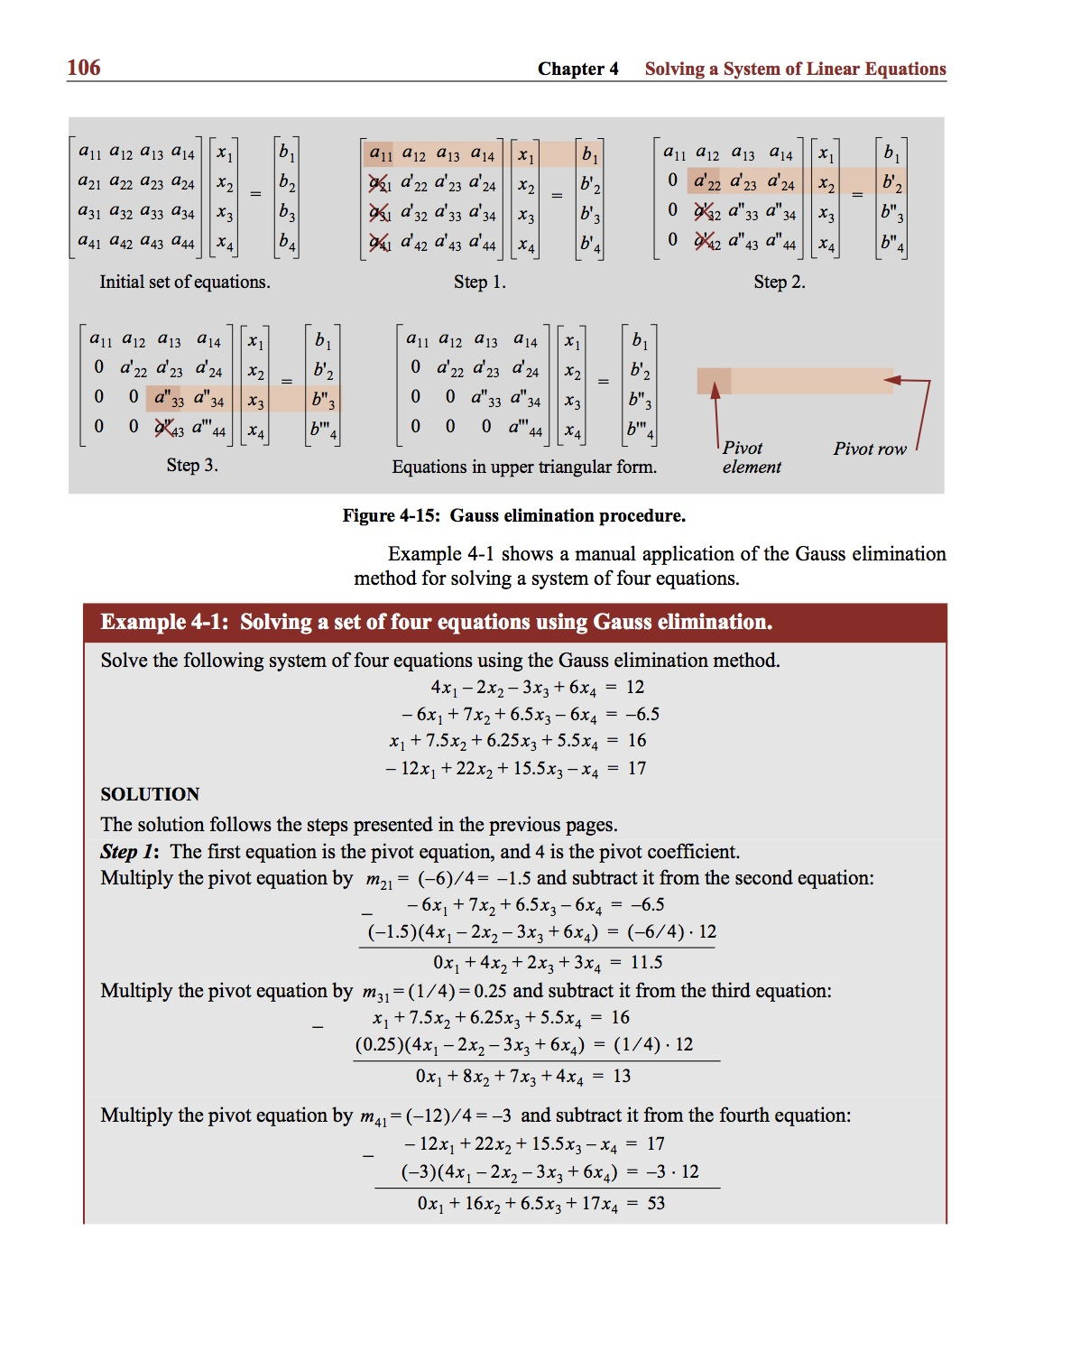
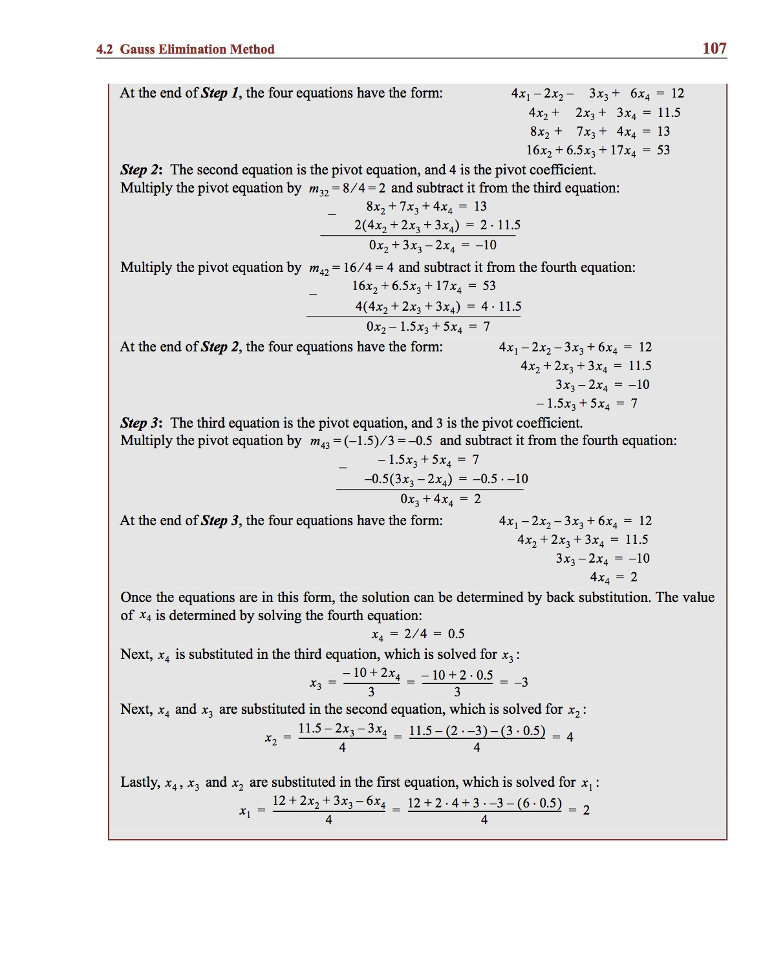
Example:

Slide 15
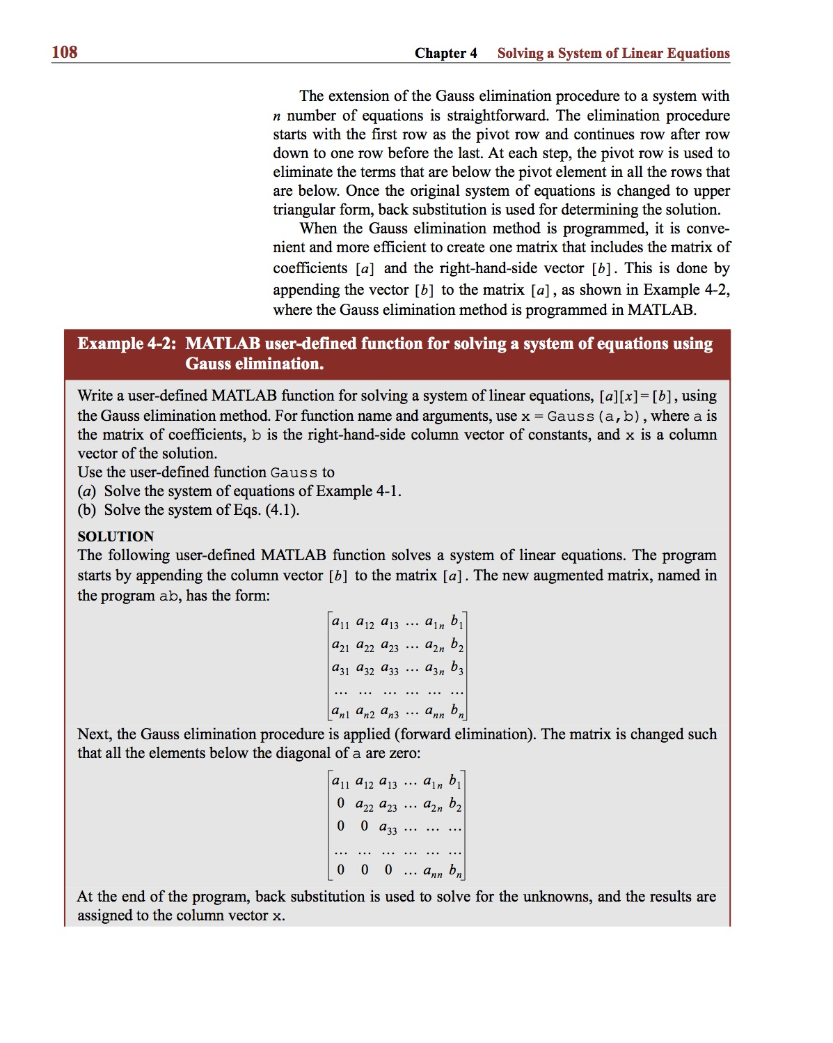
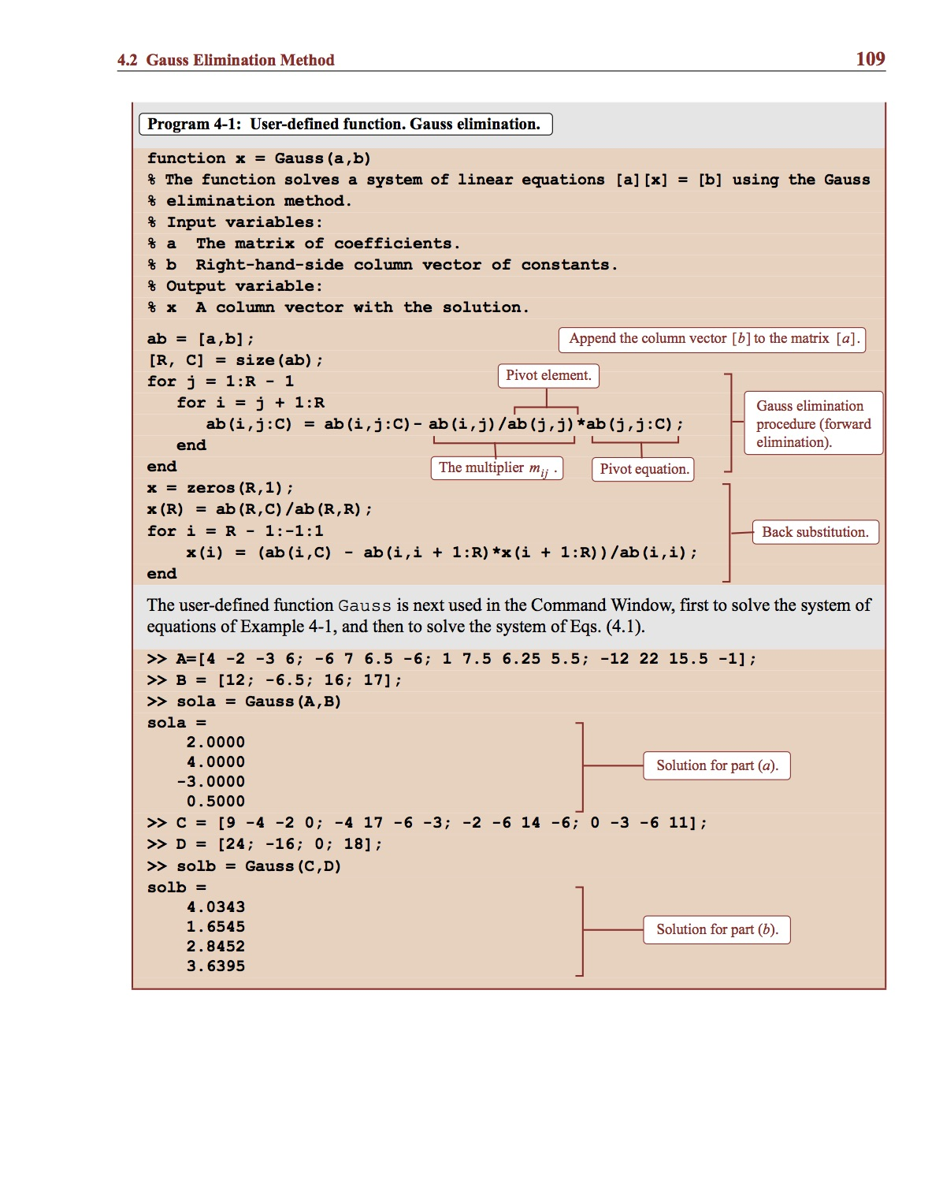
Example:

Slide 16
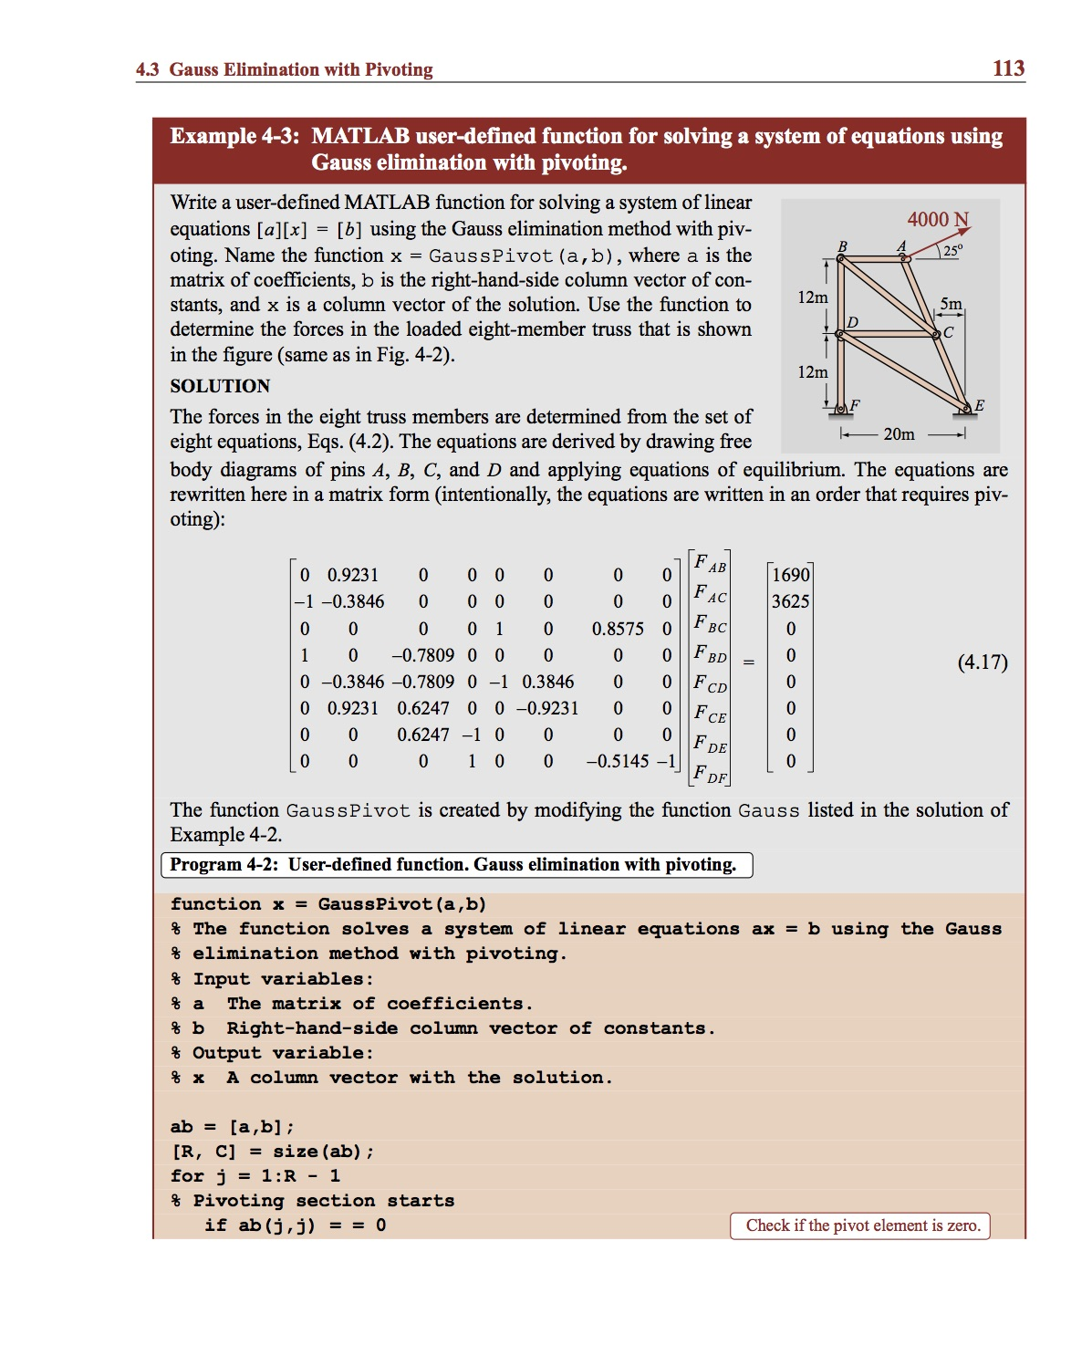
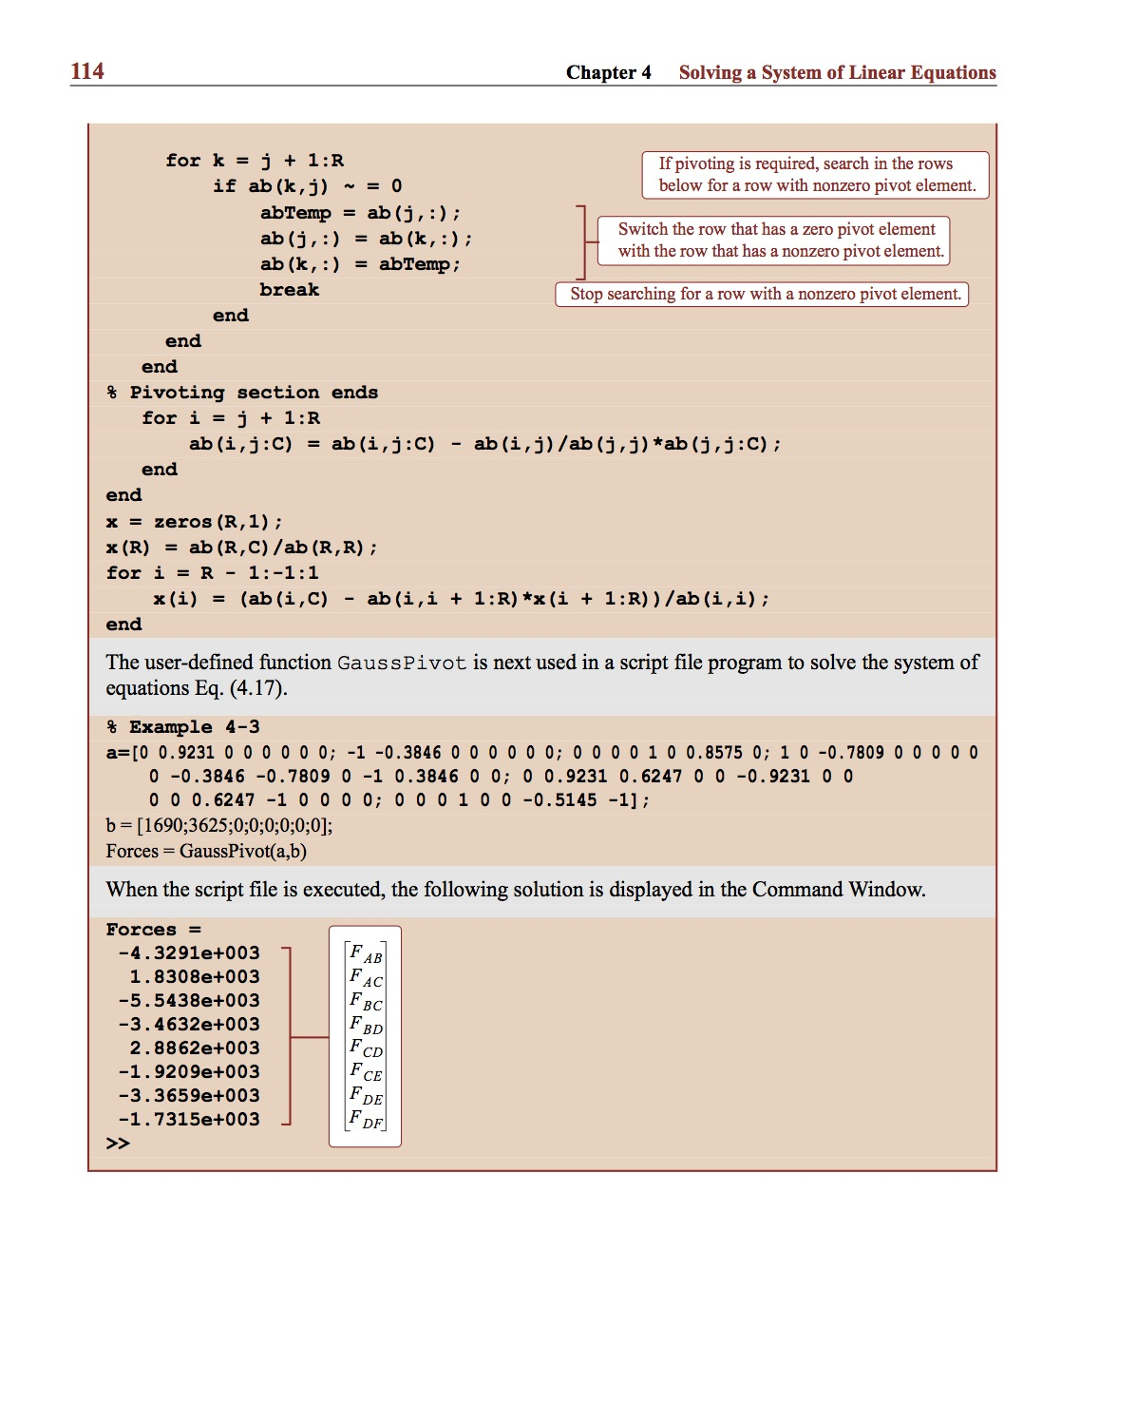
Example:

Slide 17
Gauss-Jordan Elimination:
The Gauss-Jordan Elimination Method is similar to Gaussian Elimination except that:
1. The pivot equation is normalised by dividing all the terms in the pivot equation by the pivot coefficient. This makes the pivot coefficient equal to 1.
2. The pivot equation is used to eliminate the off-diagonal terms in ALL equations.
The result is a diagonal matrix that can easily be solved.
Pivoting applies as with Gaussian Elimination.

Slide 18
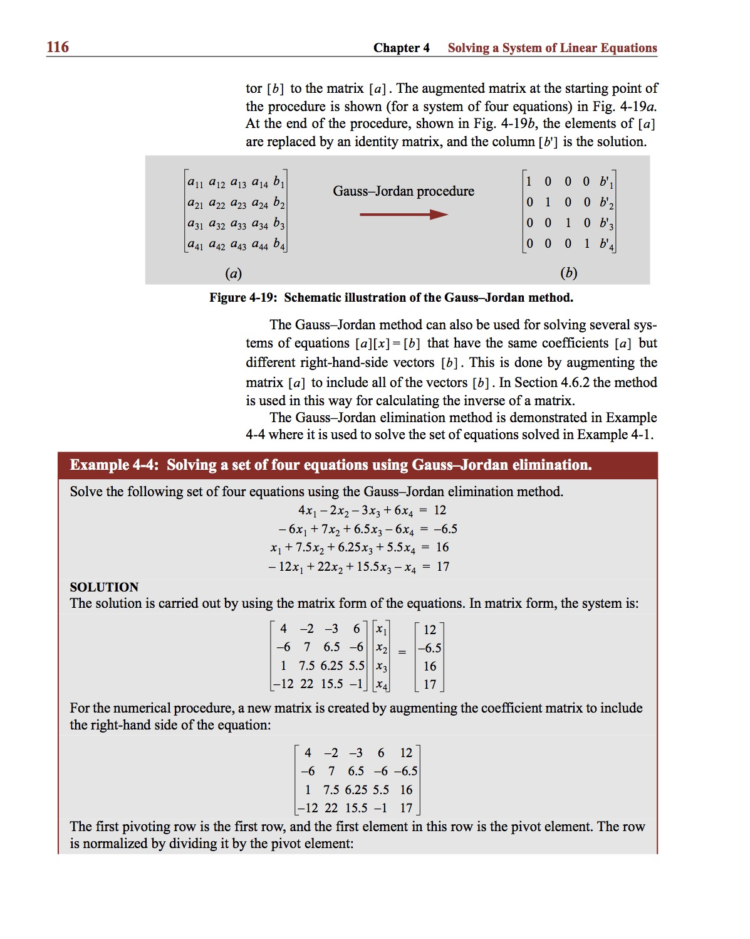
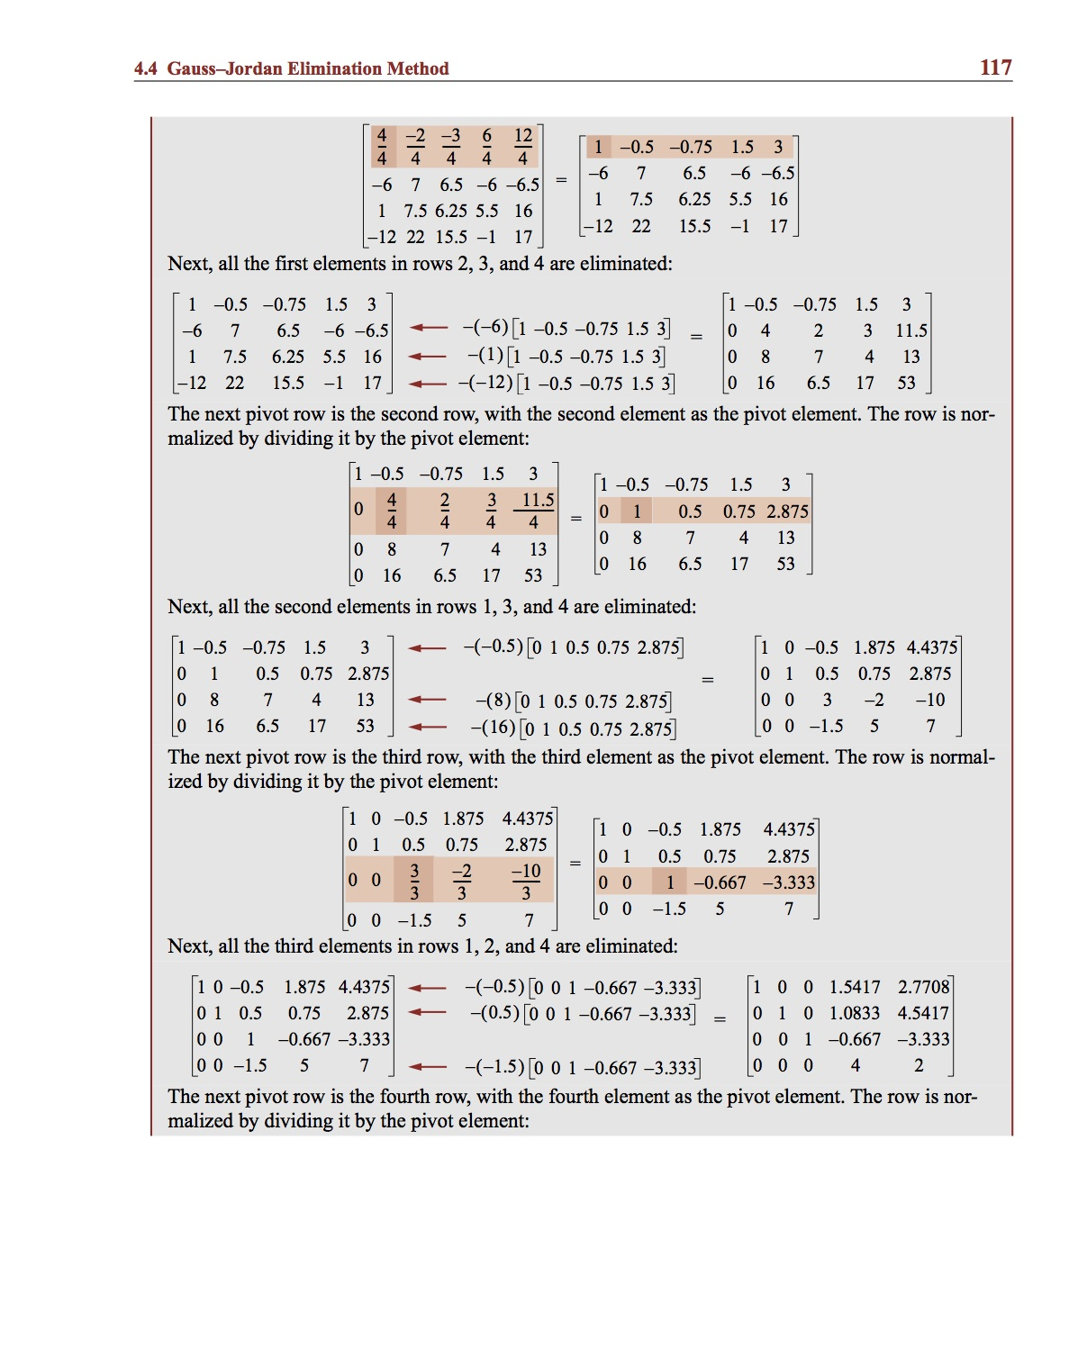
Example:

Slide 19
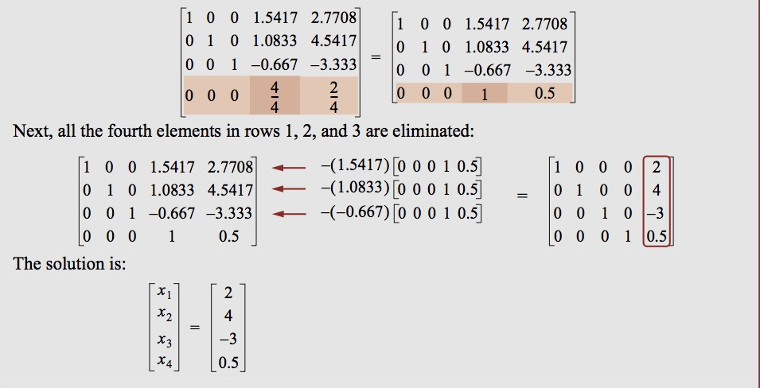
Example:

Slide 20
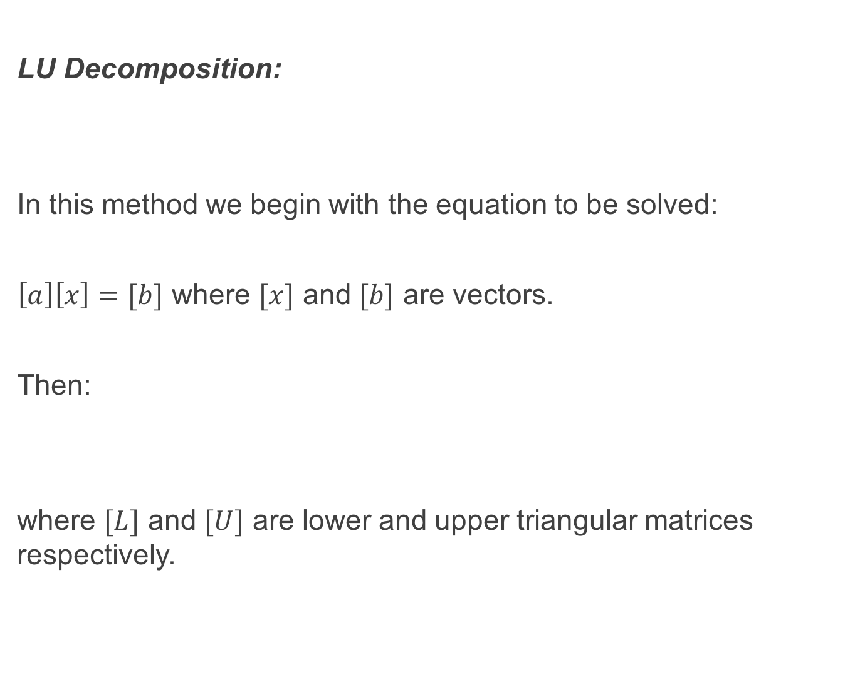
LU Decomposition:
In this method we begin with the equation to be solved:
$\left[a\right]\left[x\right]=[b]$ where $[x]$ and $[b]$ are vectors.
Then:
where $[L]$ and $[U]$ are lower and upper triangular matrices respectively.

Slide 21
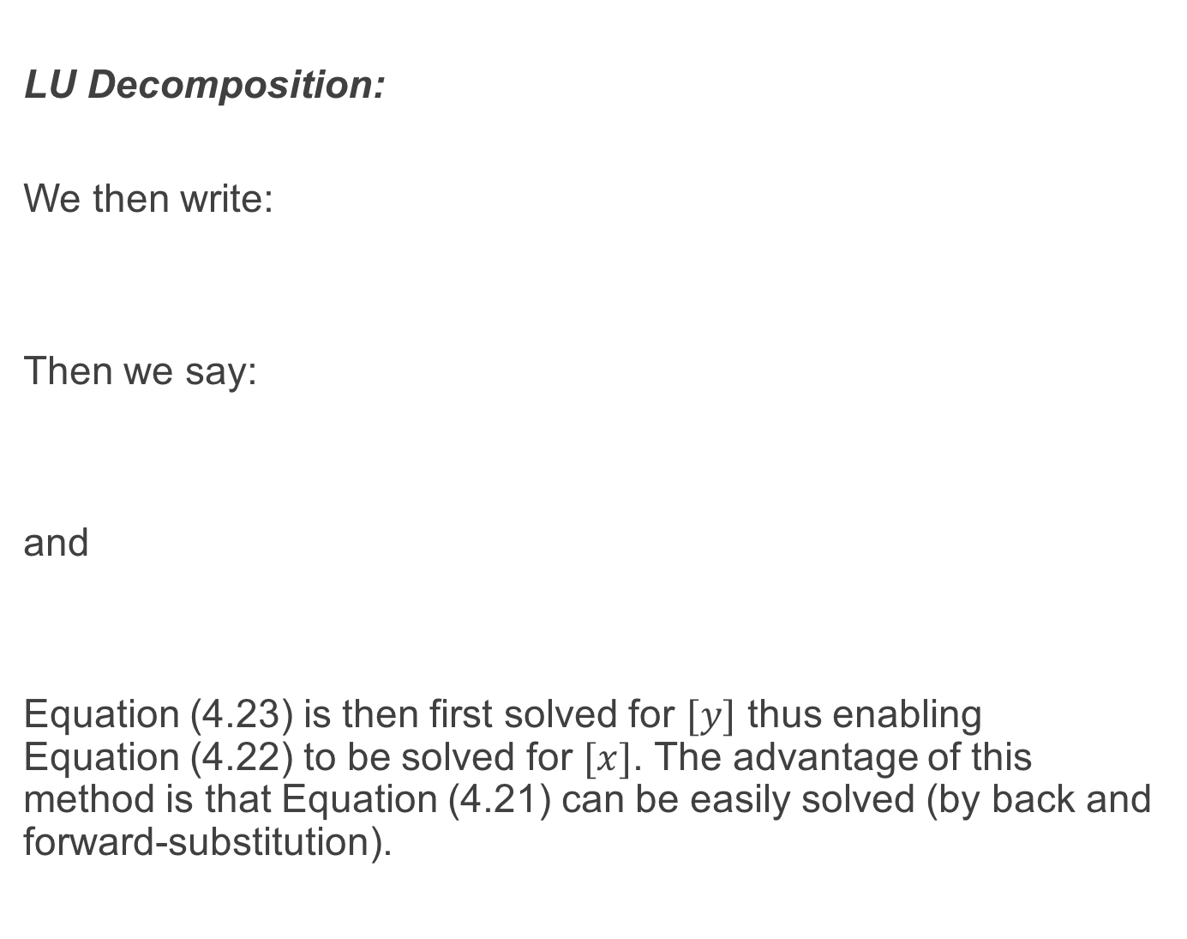
LU Decomposition:
We then write:
Then we say:
and
Equation (4.23) is then first solved for $[y]$ thus enabling Equation (4.22) to be solved for $[x]$. The advantage of this method is that Equation (4.21) can be easily solved (by back and forward-substitution).

Slide 22
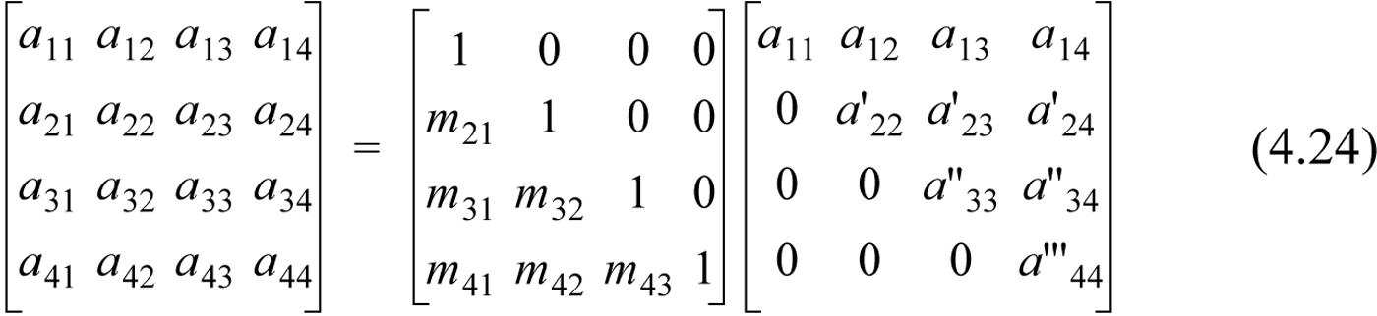
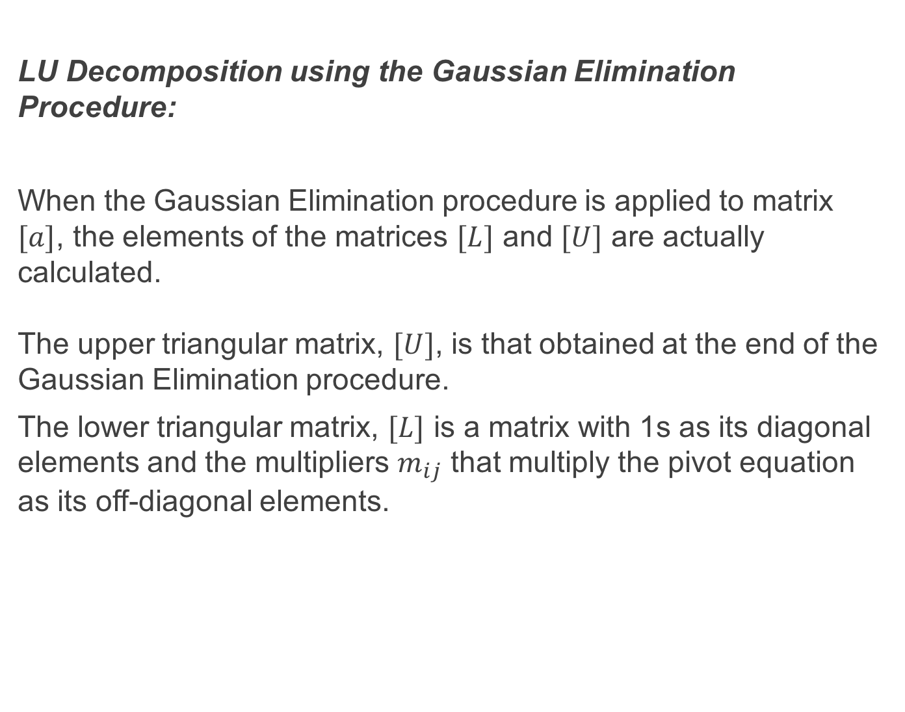
LU Decomposition using the Gaussian Elimination Procedure:
When the Gaussian Elimination procedure is applied to matrix $[a]$, the elements of the matrices $[L]$ and $[U]$ are actually calculated. The upper triangular matrix, $[U]$, is that obtained at the end of the Gaussian Elimination procedure.
The lower triangular matrix, $[L]$ is a matrix with 1s as its diagonal elements and the multipliers $m_{ij}$ that multiply the pivot equation as its off-diagonal elements.

Slide 23
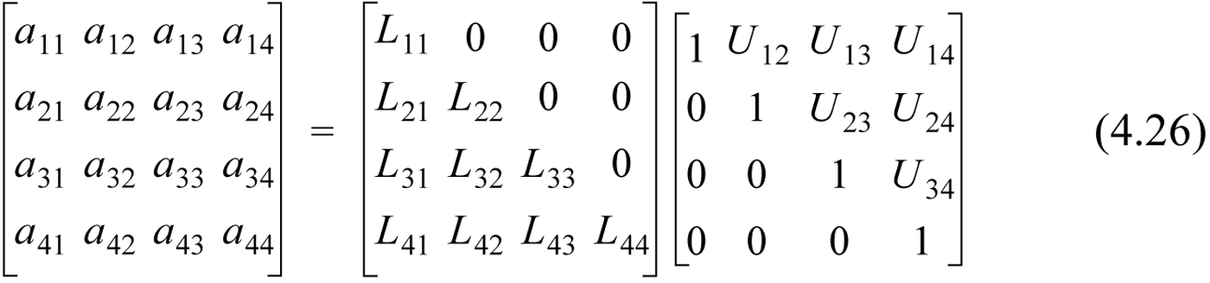
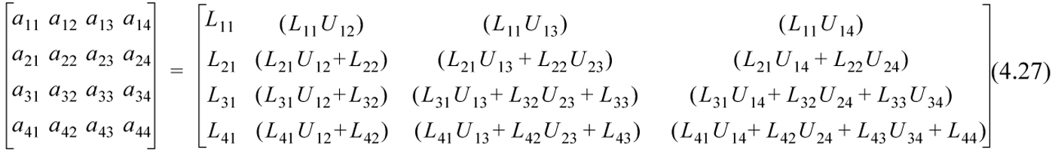
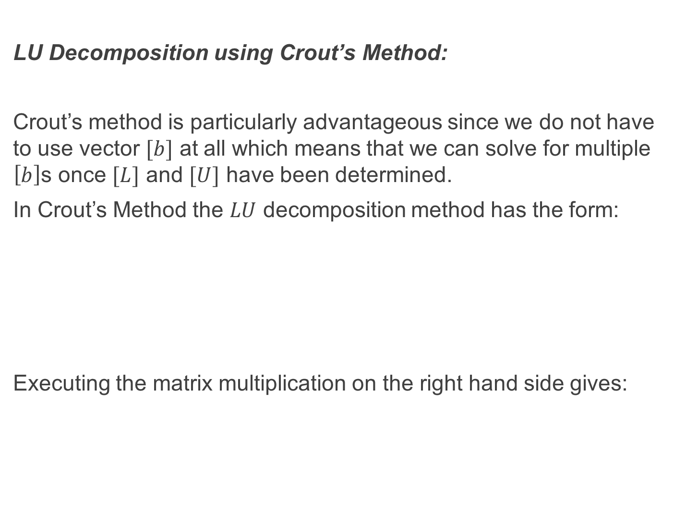
LU Decomposition using Crout’s Method:
Crout’s method is particularly advantageous since we do not have to use vector $[b]$ at all which means that we can solve for multiple $\left[b\right]$s once $[L]$ and $[U]$ have been determined.
In Crout’s Method the $LU$ decomposition method has the form:
Executing the matrix multiplication on the right hand side gives:

Slide 24
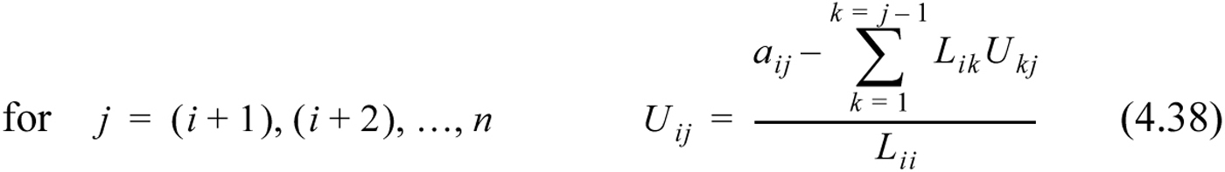
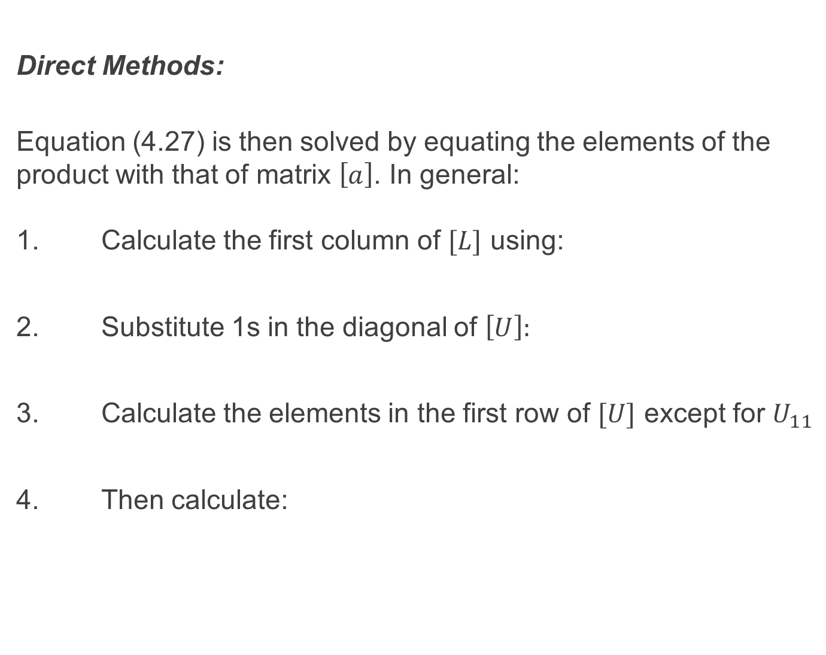
Direct Methods:
Equation (4.27) is then solved by equating the elements of the product with that of matrix $\left[a\right]$. In general: 1. Calculate the first column of $[L]$ using:
2. Substitute 1s in the diagonal of $\left[U\right]:$
3. Calculate the elements in the first row of $[U]$ except for $U_{11}$
4. Then calculate:

Slide 25
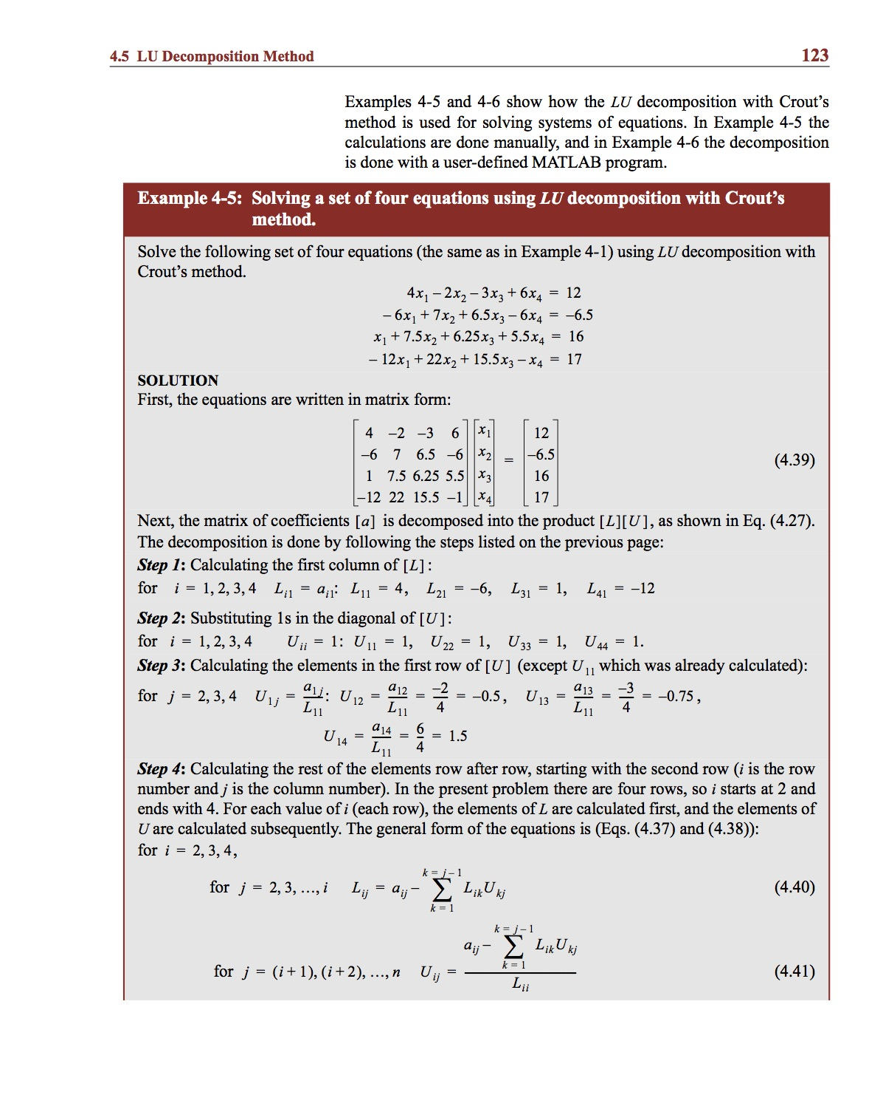
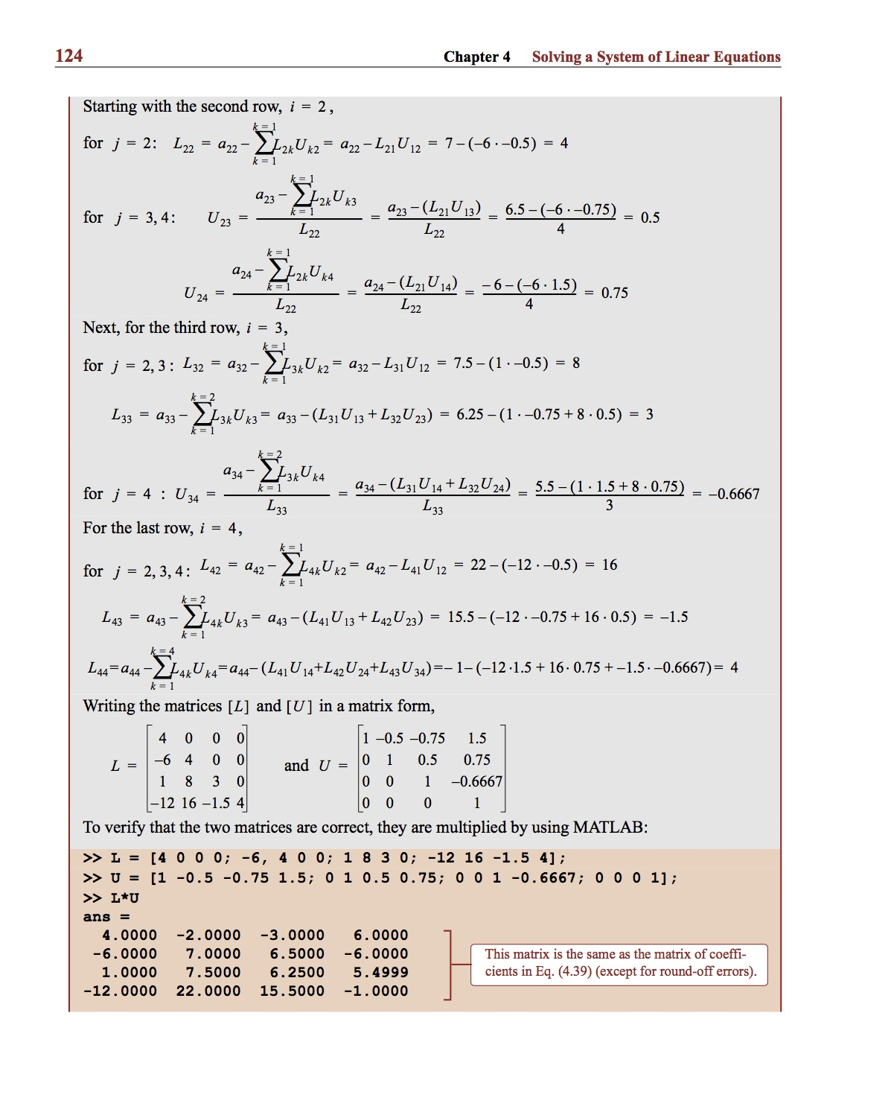
Example:

Slide 26
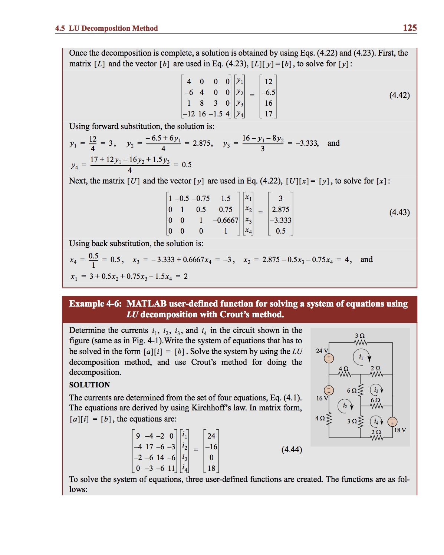
Example:

Slide 27
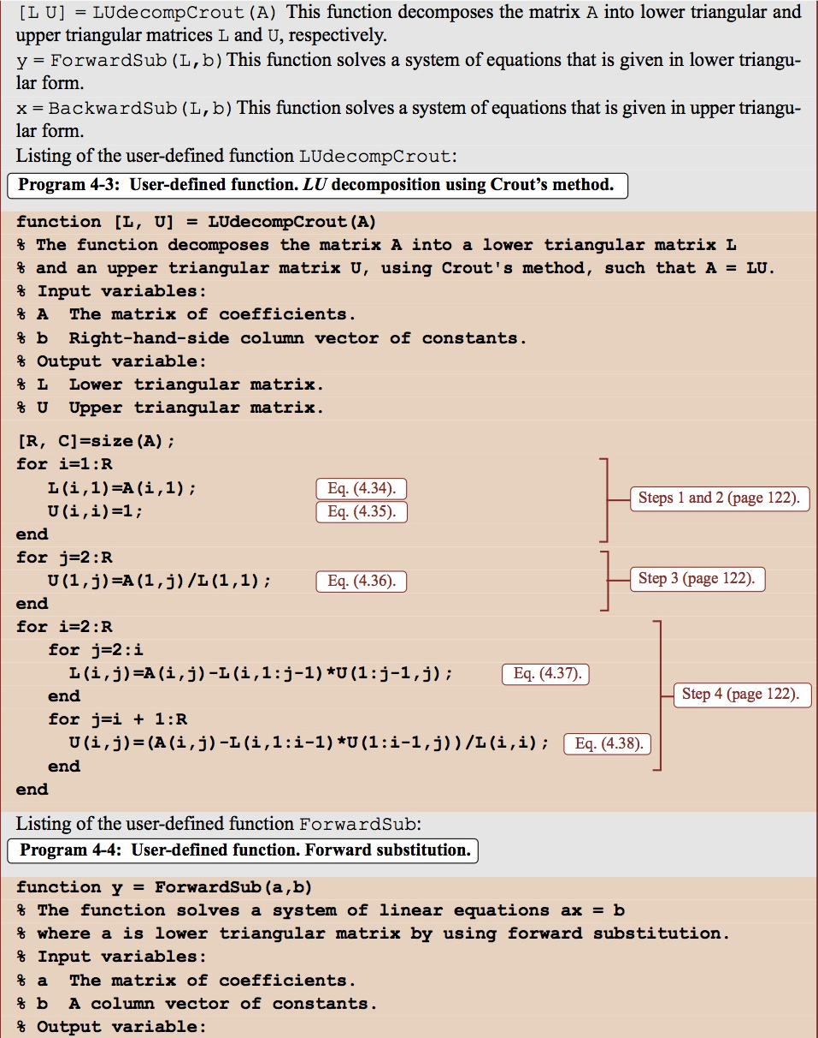
Example:

Slide 28
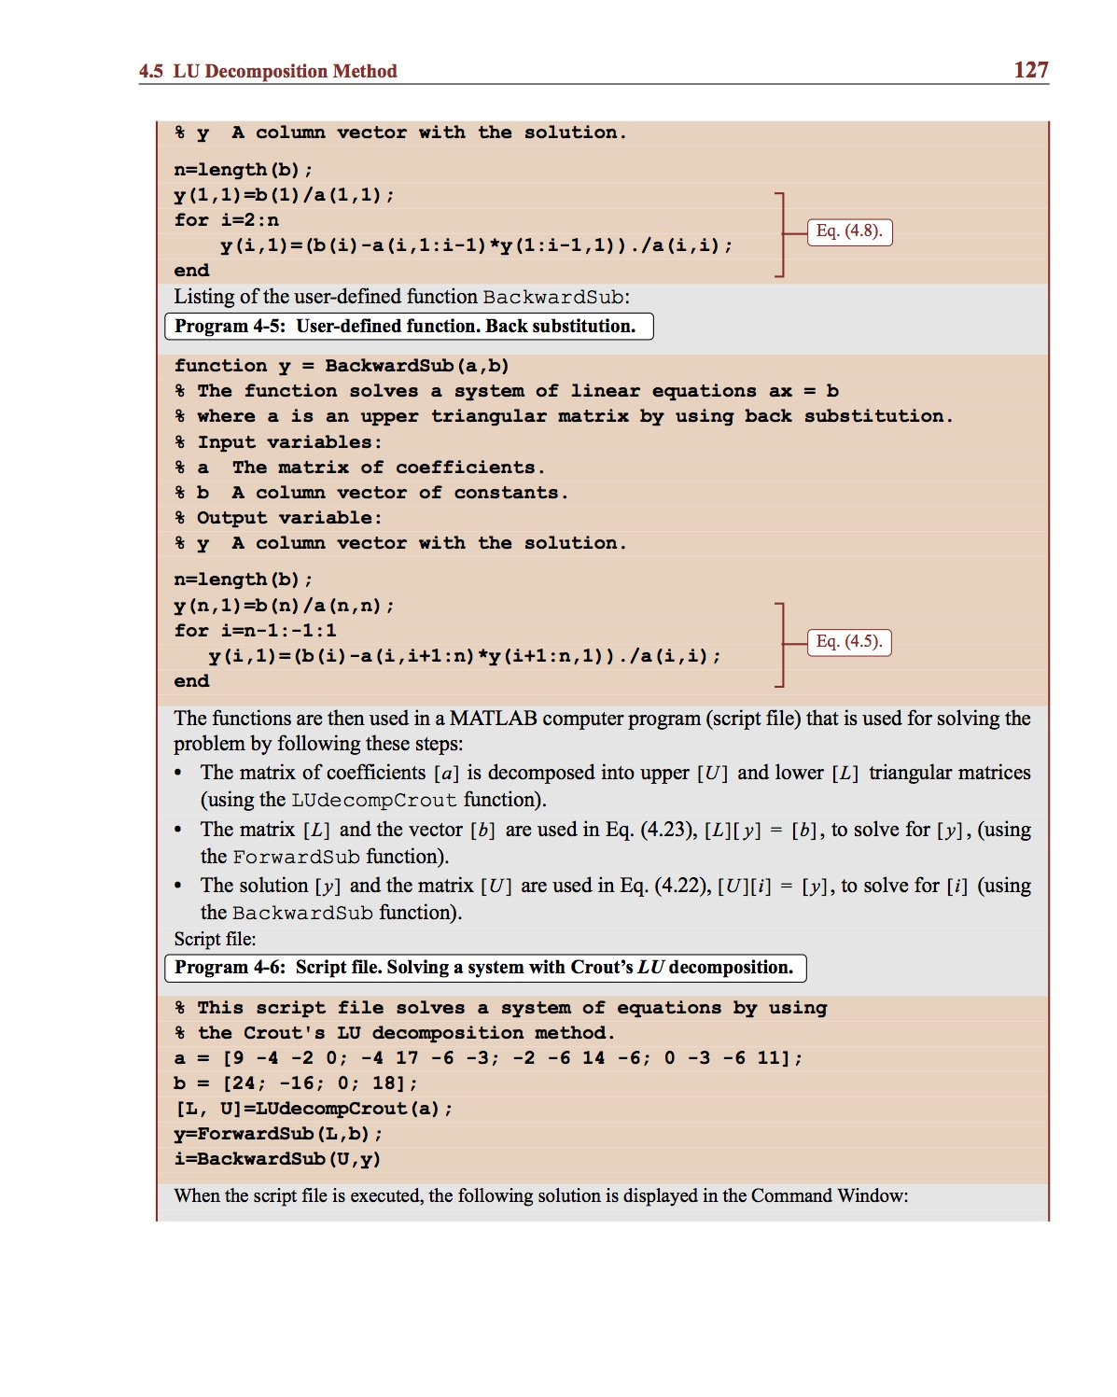
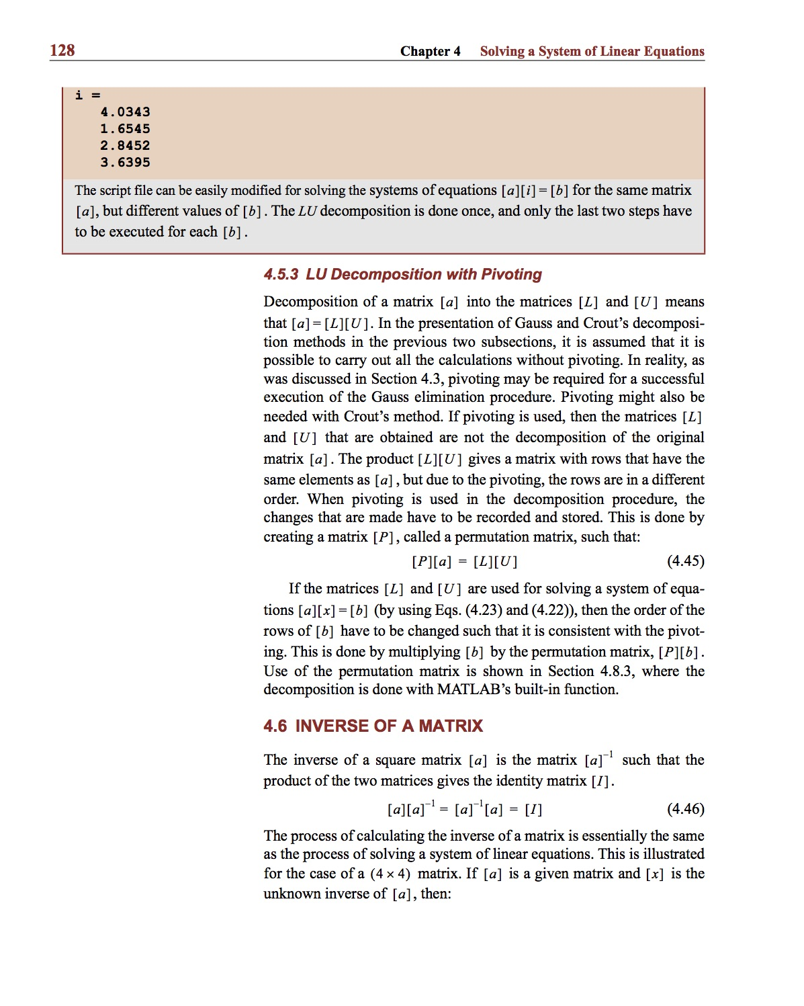
Example:

Slide 29
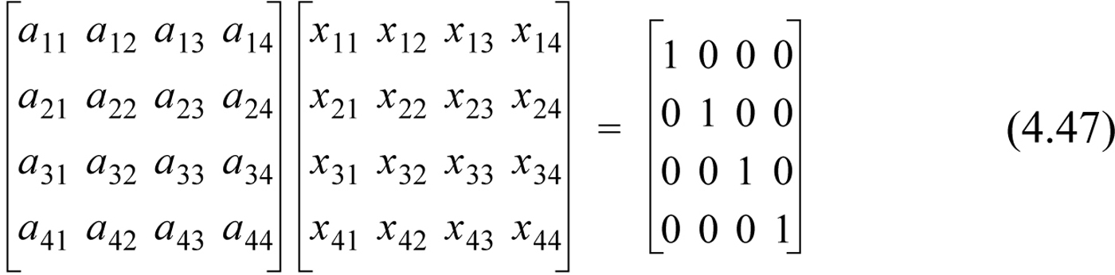
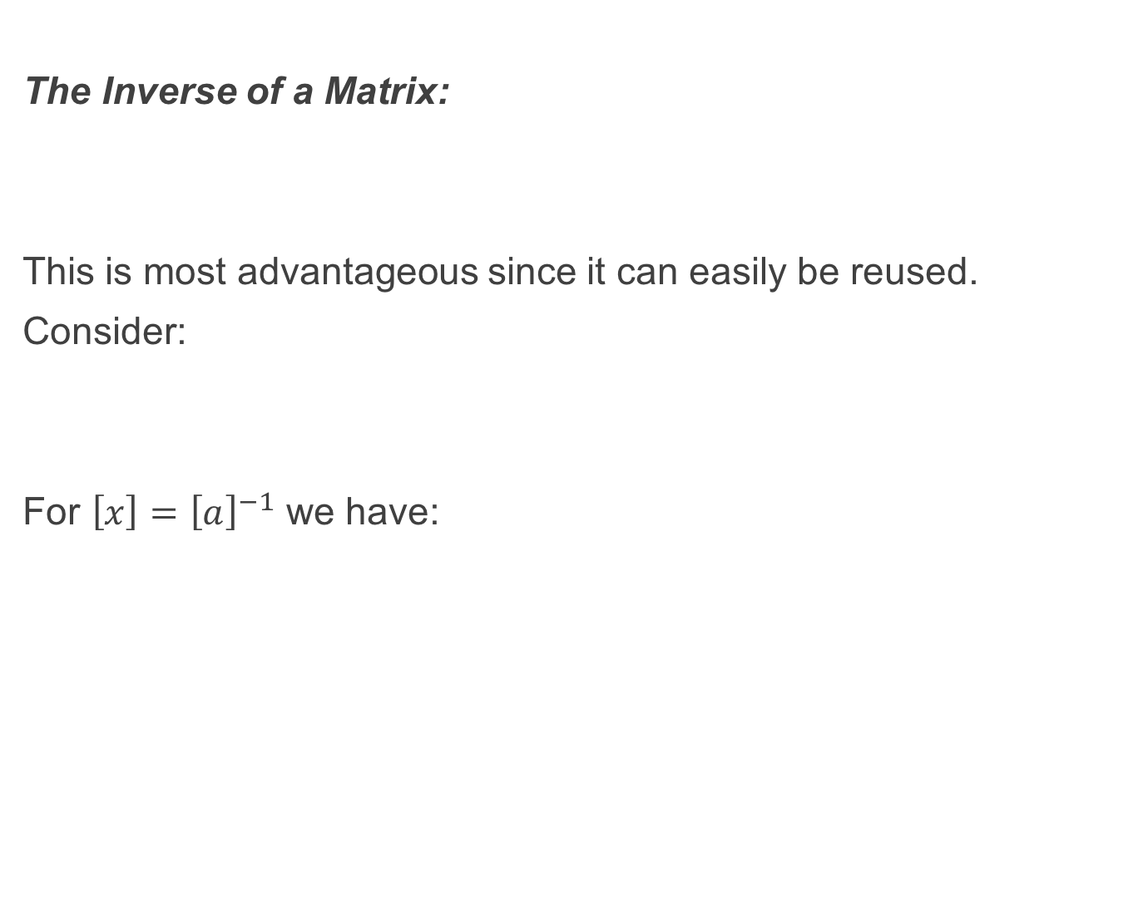
The Inverse of a Matrix:
This is most advantageous since it can easily be reused.
Consider:
For $\left[x\right]={\left[a\right]}^{−1}$ we have:

Slide 30
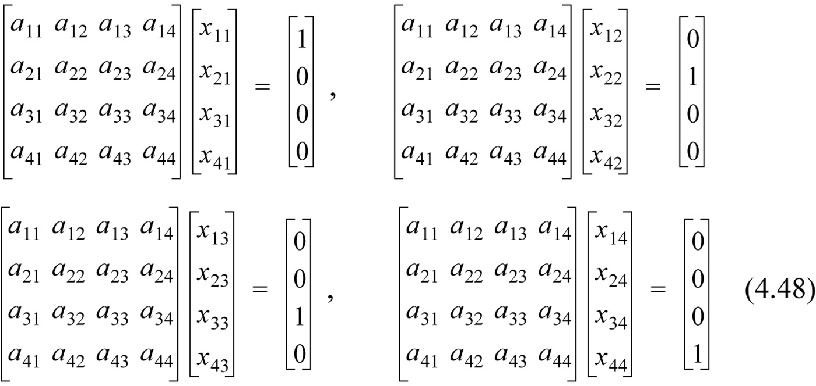
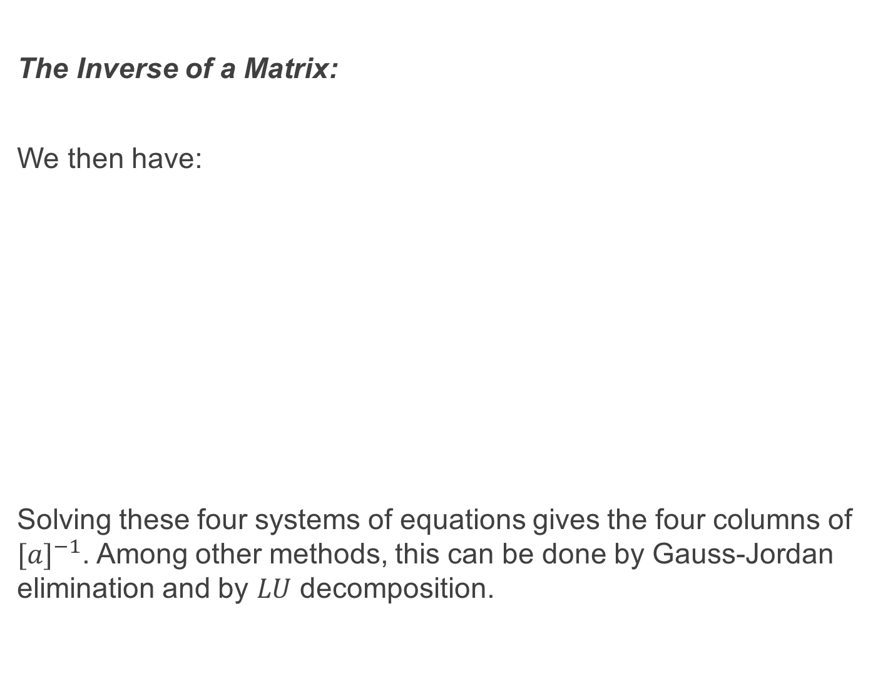
The Inverse of a Matrix:
We then have:
Solving these four systems of equations gives the four columns of ${[a]}^{−1}$. Among other methods, this can be done by Gauss-Jordan elimination and by $LU$ decomposition.

Slide 31

The Inverse of a Matrix by LU Decomposition and Gauss-Jordan Elimination:
We obtain each column of the inverse matrix by solving the system of equations in (4.48).
This can be done by direct application of $LU$ decomposition or Gauss-Jordan elimination on each of these four equations

Slide 32


Example:

Slide 33




Iterative Methods:
We examine the Jacobi and Gauss-Seidel iterative methods here. The system of linear equations is written in explicit form:
The idea is to assume an initial solution for $[x]$ and then recursively substitute these values into the r.h.s. of the above explicit form and so obtain new estimates for $\left[x\right].$
A sufficient, but not necessary, condition for convergence is:

Slide 34



The Jacobi Iterative Method:
An initial solution for $[x]$ is chosen. If no information is available then $\left[x\right]=0$. The values for $x$ are substituted into the r.h.s. of the explicit representation of the system of equations and a new estimate for $[x]$ is found. This process is repeated recursively. That is:
The process is continued until the absolute value of the estimated relative error of all unknowns is less than some predetermined value:

Slide 35

The Gauss-Seidel Iterative Method: To begin with, all unknowns $x_{j}$ except for $x_{1}$are initialised with some approximate values. These can be zero if approximate values are unknown.
Using these values, with $i=1$ in Equation (4.51), we calculate $x_{1}$. With $i=2$ in Equation (4.51), we calculate a new value for $x_{2}$ and so on. This completes the first iteration. The second iteration starts with $i=1$ in Equation (4.51) where a new value of $x_{1}$ is calculated. With $i=2$ a new value of $x_{2}$ is calculated and so on.
The iterations are repeated until:

Slide 36


The Gauss-Seidel Iterative Method:
Mathematically the Gauss-Seidel algorithm can be written:
The Gauss-Seidel algorithm converges faster than the Jacobi method and like the Jacobi method the sufficient but not necessary condition for convergence is that $\left[a\right]$ is diagonally dominant.

Slide 37


Example:

Slide 38

Example:

Slide 39


Tridiagonal Systems of Equations:
These can be readily solved using previous methods but many elements of $[a]$ are zero. This means more storage space and many redundant zero multiplications and additions. The Thomas algorithm is a commonsense approach to the problem. Instead of performing Gaussian elimination on $[a]$ as a whole we store the diagonal and off-diagonal entries as separate vectors. We then apply Gaussian elimination as before.

Slide 40


Example:

Slide 41

Error and Residual: Consider the equation $\left[a\right]\left[x\right]=\left[b\right].$ The true error is the vector:
But because $[x_{TS}]$ cannot in general be calculated we instead use the residual error $\left[r\right]:$
$$⟹[e]= {[a]}^{−1}[r]$$ The smaller the elements in $[r]$ the better $[x_{NS}]$ satisfies the equation. However this does not necessarily tell us how close $[x_{NS}]$ is to $[x_{TS}]$ (see Equation (4.68) – that depends on ${[a]}^{−1}$).

Slide 42

Example:

Slide 43



Norms:
The norm of a vector or matrix is a number that in some way indicates collectively the size of the vector or matrix elements. There are various definitions for the norm, each with their own uses, of a vector $[v]$ or a matrix $[a]$. We will concern ourselves with the Euclidean 2-norm in this course: Vector Norms:
The infinity norm ($l_{∞}$norm):
The 1-norm ($l_{1}$ norm):
The Euclidean 2-norm ($l_{2}$ norm):
This latter one is also referred to as the magnitude of the vector $[v]$ with which you are already familiar.

Slide 44





Norms:
Matrix Norms:
The infinity norm ($l_{∞}$norm):
The 1-norm ($l_{1}$ norm):
The 2-norm ${(l}_{2}$ norm):
where $[v]$ is an eigenvector of $\left[a\right].$
The Euclidean Norm:

Slide 45

Properties of Norms:
1. The norm of a vector or matrix $[a]$, denoted $\left\|a\right\|$, is a positive quantity and is equal to zero $iff \left[a\right]=0$.
2. $\left\|α[a]\right\|=\left|α\right|\left\|[a]\right\| ∀α$. This means $\left\|[−a]\right\|=\left\|[a]\right\|≥0$.
3. $\left\|\left[a\right][x]\right\|≤\left\|[a]\right\|\left\|x\right\|$.
4. $\left\|[a+b]\right\|≤\left\|\left[a\right]\right\|+\left\|b\right\|$ - the triangle inequality.

Slide 46

Using Norms to Determine Error Bounds:
It can be shown that:
This useful result gives an upper and lower bound to error relative to the true solution.

Slide 47

The Condition Number of a Matrix:
This tells us how stable the solution to a system of equations is.
This number shows how a small perturbation in $[a]$ will affect the solution. If the condition number is much greater than 1 then a small perturbation in $[a]$ will greatly affect the solution. In this case the matrix $[a]$ is said to be ill-conditioned.
By contrast, if a small perturbation in $[a]$ does not affect the solution greatly then $[a]$ is said to be well-conditioned.
The condition number of a matrix $[a]$ is given by:

Slide 48


The Condition Number of a Matrix:
Take, for example the following system of equations:
The solution of this system is:
$$x_{1}=45, { x}_{2}=130$$
If we now change $a_{22}$ slightly to 3.84 then:
$x_{1}=110, x_{2}=325$
It is clear that $\left[a\right]=\left(\begin{matrix}6 & 2 \\ 11.5 & 3.85\end{matrix}\right)$ is ill-conditioned. In fact it has a condition number greater that ~1500 regardless of what norm is used.

Slide 49


Example:

Slide 50

Condition Number of a Matrix:

Slide 51
Recommended Problems:
Problems to be solved by hand (do at least 2):
4.2, 4.13, 4.19
Problems to be programmed in MATLAB:
4.25
Problems in math, science and engineering:
4.34
You should pick out problems that you find interesting/challenging and do these too.

